Slide 1

Unit – 1
Basic Matrix Algebra
B.Tech. $→$1st Semester
Mathematics – I (2601HS101)
Course Outcome:
At the end of this unit, students will be able to apply matrix operations and methods for solving systems of linear equations and related problems.

Slide 2

Topics of Unit 1
  Matrix
  Types of Matrices
  Operations on Matrices
  Determinant and Its Properties
  Row - Echelon Form
  Reduced Row - Echelon Form
  Rank of a Matrix
  System of Simultaneous Linear Equations
    Gauss Elimination Method
    Gauss - Jordan Elimination Method
Looping

Slide 3

Topics of Unit 1 (Continue)
  Inverse of a Matrix by the Gauss - Jordan Method
  Applications of Linear Systems
Looping

Slide 4

Outline of Unit 1
  Operations on Matrices and Types of Matrices
  Determinant and Its Properties
  Echelon Forms and Rank of a Matrix
  Gauss Elimination Method
  Gauss - Jordan Elimination Method
  Inverse of a Matrix by the Gauss - Jordan Method
  Applications of Linear Systems
Looping

Slide 5
Matrix

Slide 6





Why Matrix ?
Ronaldo
R
B
M
R
$$0$$
$$1$$
$$1$$
B
$$1$$
$$0$$
$$1$$
M
$$0$$
$$2$$
$$0$$
Messi
Matrix
Beckham

Slide 7
Matrix
A rectangular array of objects arranged in rows and columns is known as a matrix.
Objects can be numbers, expressions, symbols, etc.
These numbers, expression or symbols are known as element or entry of a matrix.
Matrix is denoted by upper case letters A, B, C, etc.
Following notations are used for matrices:

Slide 8
Matrix
For Example:
$B=\left[ \begin{matrix}+ & − \\ \% & ∪ \\ ∆ & ℕ\end{matrix} \right],$
$C=\left[ \begin{matrix}x+y & x^{2}+3 & x \\ 5 & y^{2} & z\end{matrix} \right]$
$A=\left[ \begin{matrix}1 & −2 \\ 3 & 5\end{matrix} \right],$
In any matrix,
  Horizontal line of elements is known as row of the matrix.
  Vertical line of elements is known as column of the matrix.
In above examples,
  Matrix $A$ has $2$ rows and $2$ columns.
  Matrix $B$ has $3$ rows and $2$ columns.
  Matrix $C$ has $2$ rows and $3$ columns.

Slide 9
Order or Size of Matrix
A matrix with $m$ rows and $n$ columns is known as a matrix of order $m×n.$
Matrix $A$ of order $m×n$ is written as $A_{m×n.}$
In general, matrix of order $m×n$ can be written as follow:
$m×n$ is read as “$m cross n$”
$$C_{1}$$
$$C_{2}$$
$$C_{3}$$
…
$$C_{n}$$
$$R_{1}$$
$$a_{11}$$
$$a_{12}$$
$$a_{13}$$
…
$$a_{1n}$$
$$R_{2}$$
$$a_{21}$$
$$a_{22}$$
$$a_{23}$$
…
$$a_{2n}$$
Element
$$A=$$
$$R_{3}$$
$$a_{31}$$
$$a_{32}$$
$$a_{33}$$
…
$$a_{3n}$$
No. of rows$=m$
…
…
…
…
…
No. of columns$=n$
$$R_{m}$$
$$a_{m1}$$
$$a_{m2}$$
$$a_{m3}$$
…
$$a_{mn}$$
$$m$$
$$×n$$

Slide 10
Matrix
$$a_{11}$$
$$a_{12}$$
$$a_{13}$$
…
$$a_{1n}$$
$$a_{21}$$
$$a_{22}$$
$$a_{23}$$
…
$$a_{2n}$$
$$A=$$
$$a_{31}$$
$$a_{32}$$
$$a_{33}$$
…
$$a_{3n}$$
…
…
…
…
$$a_{m1}$$
$$a_{m2}$$
$$a_{m3}$$
…
$$a_{mn}$$
$$m$$
$$×n$$
OR $A={\left[ a_{ij} \right]}_{m×n}$
$;1≤i≤m$
$, 1≤j≤n$
Where, $a_{ij}$is the element of $i^{th}$ row and $j^{th}$ column of the matrix $X.$
The number of elements of a matrix of order $m×n$ is $m∙n.$

Slide 11
Method-1
Operations on Matrices and Types of Matrices

Slide 12
Operations on Matrices

Slide 13
Addition of Matrices
Let$A=\left[ a_{ij} \right] \text{and} B=\left[ b_{ij} \right]$be two matrices with equal order$m×n\text{, }$then addition of matrices$A$and$B$is denoted by $A+B$ & defined as
$$A+B=\left[ a_{ij} + b_{ij} \right]$$
$\text{Example}\text{:}$ $\text{Let} A=\left[ \begin{matrix}1 & −2 & 3 \\ 6 & 9 & 2\end{matrix} \right]$ and $B=\left[ \begin{matrix}2 & 8 & −5 \\ 0 & 2 & 11\end{matrix} \right]$, then
$$=\left[ \begin{matrix}1 & −2 & 3 \\ 6 & 9 & 2\end{matrix} \right]+\left[ \begin{matrix}2 & 8 & −5 \\ 0 & 2 & 11\end{matrix} \right]$$
$$A+B$$
$$=\left[ \begin{matrix}3 & 6 & −2 \\ 6 & 11 & 13\end{matrix} \right]$$

Slide 14
Difference of Matrices
Let$A=\left[ a_{ij} \right] \text{and} B=\left[ b_{ij} \right]$be two matrices with equal order$m×n\text{, }$then difference of matrices$A$and$B$is denoted by $A−B$ & defined as
$$A−B=\left[ a_{ij} − b_{ij} \right]$$
$\text{Example}\text{:}$ $\text{Let} A=\left[ \begin{matrix}1 & −2 & 3 \\ 6 & 9 & 2\end{matrix} \right]$ and $B=\left[ \begin{matrix}2 & 8 & −5 \\ 0 & 2 & 11\end{matrix} \right]$, then
$$=\left[ \begin{matrix}1 & −2 & 3 \\ 6 & 9 & 2\end{matrix} \right]−\left[ \begin{matrix}2 & 8 & −5 \\ 0 & 2 & 11\end{matrix} \right]$$
$$A−B$$
$$=\left[ \begin{matrix}−1 & −10 & 8 \\ 6 & 7 & −9\end{matrix} \right]$$

Slide 15
Multiplication of Matrix by a Scalar
Let $A=\left[ a_{ij} \right]$be a matrix of order $m×n$ and $k$ be any non-zero real number, then multiplication of matrix $A$by a scalar $\text{k}$is written as$k⋅A$or$kA$& defined as
$$k⋅A=\left[ k⋅a_{ij} \right]$$
$\text{Example}\text{:}$ $\text{Let} A=\left[ \begin{matrix}0 & 4 & −3 \\ −7 & 5 & 10\end{matrix} \right]$ and$k=5$be any non-zero real number, then
$$=5⋅\left[ \begin{matrix} 0 & 4 & −3 \\ −7 & 5 & 10\end{matrix} \right]$$
$$5⋅A$$
$$=\left[ \begin{matrix} 0 & 20 & −15 \\ −35 & 25 & 50\end{matrix} \right]$$

Slide 16
$$\text{Properties} \text{of} \text{Matrix} \text{Addition}\text{, }\text{Difference}\text{ \& }\text{Scalar} \text{Multiplication}$$
Let$A$, $B$and $C$ be three matrices with same order &$α$and$β$are scalars, then
  $A+B=B+A$ ( Commutative Law )
  $A−B≠B−A$
  $A+\left( B+C \right)=\left( A+B \right)+C$ ( Associative Law )
  $A−\left( B−C \right)≠\left( A−B \right)−C$
  $A+O=O+A=A$ ( Existence of Additive Identity )
  $A+\left( −A \right)=\left( −A \right)+A=O$ ( Existence of Additive Inverse )
  $α\left( A±B \right)=αA±αB$ ( Distributive Law )
  $\left(α±β\right)A=αA±βA$

Slide 17
Multiplication of Matrices
Multiplication of two matrices $A$ and $B$ is denoted as $AB$ and it is defined if
$\text{N}\text{o}\text{. }\text{of} \text{columns} \text{in} \text{A} = \text{No}\text{. }\text{of} \text{rows} \text{in} \text{B}$
  $\text{Example}\text{:} \text{Let} A={\left[ \begin{matrix}1 & −2 & 3 \\ 6 & 9 & 2\end{matrix} \right]}_{2×3}$and$B={\left[ \begin{matrix}2 & 8 & 1 \\ 0 & 2 & 4 \\ −7 & −5 & 2\end{matrix} \right]}_{3×3}$
    Here, No. of columns in matrix A $=$ No. of rows in matrix B$=3$
    Therefore,$AB$is defined.

Slide 18
Multiplication of Matrices
Multiplication of two matrices $B$ and $A$ is denoted as $BA$ and it is defined if
$\text{N}\text{o}\text{. }\text{of} \text{columns} \text{of} \text{B} = \text{No}\text{. }\text{of} \text{rows} \text{of} \text{A}$
  $\text{Example}\text{:} \text{Let} A={\left[ \begin{matrix}1 & −2 & 3 \\ 6 & 9 & 2\end{matrix} \right]}_{2×3}$and$B={\left[ \begin{matrix}2 & 8 & 1 \\ 0 & 2 & 4 \\ −7 & −5 & 2\end{matrix} \right]}_{3×3}$
    Here, No. of columns of matrix B $=3$ and No. of rows of matrix A$=2$.
    Therefore,$BA$is not defined.

Slide 19
Multiplication of Matrices
Let $A=\left[ a_{ik} \right]$ be $m×p$ matrix and $B=\left[ b_{kj} \right]$ be a$p×n$ matrix. The resultant matrix $AB=\left[ c_{ij} \right]$ is $m×n$ matrix.
Here, $ij^{th}−entry$ is obtained by multiplying the $i^{th}$ row of $A$ by the $j^{th}$ column of B.
$\left[\begin{matrix}a_{11} & a_{12} & … & a_{1p} \\ ⋮ & ⋮ & … & ⋮ \\ a_{i1} & a_{i2} & … & a_{ip} \\ ⋮ & ⋮ & ⋱ & ⋮ \\ a_{m1} & a_{m2} & … & a_{mp}\end{matrix}\right]$ $\left[\begin{matrix}b_{11} & … & b_{1j} & … & b_{1n} \\ b_{21} & … & b_{2j} & … & b_{2n} \\ ⋮ & ⋮ & ⋮ & ⋱ & ⋮ \\ b_{p1} & … & b_{pj} & … & b_{pn}\end{matrix}\right]=\left[\begin{matrix}c_{11} & … & a_{1n} \\ ⋮ & … & ⋮ \\ ⋮ & c_{ij} & ⋮ \\ ⋮ & ⋱ & ⋮ \\ c_{m1} & … & a_{mn}\end{matrix}\right]$
$$i.e. ,c_{ij}=a_{i1}⋅b_{1j} + a_{i2}⋅b_{2j} +…+ a_{ip}⋅b_{pj}$$

Slide 20
Results on Matrix Multiplication
Let $A\text{, }B$ and $C$ be three matrices with suitable order & $k$ be a scalar.
  $\left(AB\right)C=A\left(BC\right)$ ( Associative Law )
  $A\left(B±C\right)=AB±AC$ ( Left Distributive Law )
  $\left(B±C \right)A=BA±CA$ ( Right Distributive Law )
  $IA=AI=A$ ( Existence of Multiplicative Identity )
  $k\left( AB \right)=\left( kA \right)B=A( kB )$

Slide 21
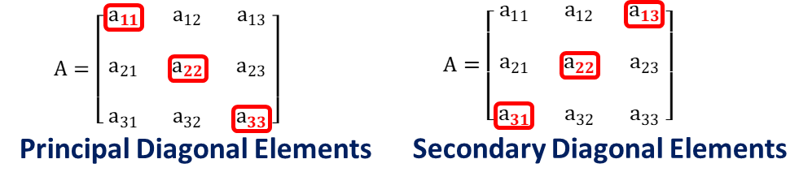
Diagonal Elements of a Matrix
In a matrix of order $n×n$,
  Principal Diagonal Elements: $a_{ij}$ for $i=j$
    For example: $a_{11}, a_{22}, a_{33}, …, a_{nn}$
  Principal diagonal elements are also known as Diagonal Elements or Main Diagonal Elements.

Slide 22
Secondary Diagonal Elements of a Matrix
In a matrix of order $n×n$,
  Secondary Diagonal Elements: $a_{ij}$ for $i+j=n+1$
    For example: $a_{1n}, a_{2\left(n−1\right)}, a_{3\left(n−2\right)}, …, a_{n1}$
  Secondary diagonal elements are also known as Anti-Diagonal Elements.

Slide 23
Trace of a Matrix
In a matrix $A$ of order $n×n$, the sum of all principal diagonal elements is known as trace of a matrix $A$.
$$a_{11}$$
$$a_{12}$$
$$a_{13}$$
$$+$$
$$a_{21}$$
$$a_{22}$$
$$a_{23}$$
$$A=$$
$$+$$
$$a_{31}$$
$$a_{32}$$
$$a_{33}$$
Trace of a matrix $A$ is denoted by $Trace(A)$ or $tr(A)$.
Example:
$A=\left[ \begin{matrix}9 & 2 & 4 \\ 0 & −1 & 1 \\ 0 & 5 & 2\end{matrix} \right]$
$⇒tr\left(A\right)=9+\left(−1\right)+2$
$=10$

Slide 24
Transpose of a Matrix
If we interchange all the rows of matrix $A$ into columns or all the columns of matrix $A$ into rows, then the resultant matrix is known as transpose of a matrix $A$.
Transpose of a matrix $A$ is denoted by $A^{T}$ or $A^{′}$.
If $A=[ a_{ij} ]$ , then $A^{T}=[ a_{ji} ]$.
If order of matrix $A$ is $m×n$, then the order of matrix $A^{T}$ is $n×m$.
Example:
$A={\left[ \begin{matrix} 1 & 3 \\ 0 & −1 \\ − 2 & 5\end{matrix} \right]}_{3×2}$
$⇒A^{T}={\left[ \begin{matrix}1 & 0 & −2 \\ 3 & −1 & 5\end{matrix} \right]}_{2×3}$

Slide 25
Properties of Transpose of a Matrix
${\left(A±B\right)}^{T}=A^{T}±B^{T}$
${\left(AB\right)}^{T}=B^{T}A^{T}$
${\left(A^{T}\right)}^{T}=A$
${\left(k∙A\right)}^{T}=k∙A^{T}, k$is a constant

Slide 26
Types of Matrices

Slide 27
Types of Matrices
1
Row Matrix
2
Column Matrix
A matrix with only one row is
A matrix with only one column is
known as a row matrix.
known as a column matrix.
Example:
Example:
$A=\left[\begin{matrix}0 \\ \sqrt{ 5 } \\ 3 \\ 1.3\end{matrix}\right]$
$A=\left[ \begin{matrix}1 & −2 & 5\end{matrix} \right]$
is a row matrix of order $1×3.$
Order of row matrix is $1×n$.
is a column matrix of order $4×1.$
Order of column matrix is $m×1$.

Slide 28
Types of Matrices
3
Square Matrix
A matrix is known as a square matrix, if the number of rows and columns are equal.
Example:
$A=\left[ \begin{matrix}1 & 7 \\ 2 & 9\end{matrix} \right]$
is a square matrix of order $2×2.$
Square matrix $A$ of order $n$, denoted by $A_{n}$.

Slide 29
Types of Matrices
4
Diagonal Matrix
A square matrix in which all the elements above and below the principal diagonal
are zero is known as a diagonal matrix.
$i.e., A=$ ${[ a_{ij} ]}_{n×n}$ is a diagonal matrix, if $a_{ij}=0,$ whenever $i≠j$
A diagonal matrix $A_{n}$ is denoted by $A_{n}=diag [ a_{11}, a_{22}, …, a_{nn} ]$.
Example:
$$a_{11}$$
$$a_{12}$$
$$a_{13}$$
$$0$$
$$0$$
$C=\left[ \begin{matrix}5 & 0 & 0 \\ 0 & 0 & 0 \\ 0 & 0 & −2\end{matrix} \right]$
$B=\left[ \begin{matrix}0 & 0 \\ 0 & 0\end{matrix} \right],$
$$a_{21}$$
$$a_{22}$$
$$a_{23}$$
$A=\left[ 4 \right],$
$$0$$
$$0$$
$$a_{31}$$
$$a_{32}$$
$$a_{33}$$
$$0$$
$$0$$
$$=diag [ 4 ]$$
$$=diag [ 0, 0 ]$$
$$=diag [ 5,0,−2 ]$$

Slide 30
Types of Matrices
5
Scalar Matrix
A diagonal matrix in which all the principal diagonal elements are same is known
as a scalar matrix.
$a_{ij}=\left\{\begin{aligned}k, \text{whenever} i=j \\ 0, \text{whenever} i≠j\end{aligned}\right.,$where$k∈ℝ$
$i.e., A={[ a_{ij} ]}_{n×n}$ is a scalar matrix, if
Example:
$C=\left[ \begin{matrix}\sqrt{ 5 } & 0 & 0 \\ 0 & \sqrt{ 5 } & 0 \\ 0 & 0 & \sqrt{ 5 }\end{matrix} \right]$
$B=\left[ \begin{matrix}0 & 0 \\ 0 & 0\end{matrix} \right],$
$A=\left[ 4 \right],$

Slide 31
Types of Matrices
6
Identity or Unit Matrix
A diagonal matrix in which all the principal diagonal elements are $1$ is known
as an identity matrix.
$$a_{ij}=\left\{\begin{aligned}1, \text{whenever} i=j \\ 0, \text{whenever} i≠j\end{aligned}\right.$$
$i.e., A={[ a_{ij} ]}_{n×n}$ is an identity matrix, if
Identity matrix of order $n$ is denoted by $I_{n×n}$ or $I_{n}$ or $I.$
Example:
$I_{3}=\left[ \begin{matrix}1 & 0 & 0 \\ 0 & 1 & 0 \\ 0 & 0 & 1\end{matrix} \right]$
$I_{2}=\left[ \begin{matrix}1 & 0 \\ 0 & 1\end{matrix} \right],$
$I_{1}=\left[ 1 \right],$

Slide 32
Types of Matrices
7
Zero Matrix OR Null Matrix
A matrix in which all elements are zero is known as a zero matrix.
Zero matrix of order $n$ is written as $O_{n×n}$ or $O_{n}$ or $O.$
Example:
$O_{3×2}=\left[ \begin{matrix}0 & 0 \\ 0 & 0 \\ 0 & 0\end{matrix} \right]$
$O_{2}=\left[ \begin{matrix}0 & 0 \\ 0 & 0\end{matrix} \right],$
$O_{1}=\left[ 0 \right],$

Slide 33
Types of Matrices
8
Upper Triangular Matrix
A square matrix in which all the elements below the principal diagonal are zero is
known as an upper triangular matrix (UTM).
$$a_{ij}=0;∀ i,j \text{with} i>j$$
$i.e., A={[ a_{ij} ]}_{n×n}$ is an upper triangular matrix, if
Example:
$$a_{11}$$
$$a_{12}$$
$$a_{13}$$
$B=\left[ \begin{matrix}1 & 2 & 2 & 4 \\ 0 & 0 & −1 & 0 \\ 0 & 0 & 7 & 6 \\ 0 & 0 & 0 & 9\end{matrix} \right]$
$A=\left[ \begin{matrix}9 & 2 & 4 \\ 0 & 1 & 1 \\ 0 & 0 & 2\end{matrix} \right]$
$$a_{21}$$
$$a_{22}$$
$$a_{23}$$
$$0$$
$$a_{31}$$
$$a_{32}$$
$$a_{33}$$
$$0$$
$$0$$

Slide 34
Types of Matrices
9
Lower Triangular Matrix
A square matrix in which all the elements above the principal diagonal are zero is
known as a lower triangular matrix (LTM).
$$a_{ij}=0;∀i,j \text{with} i<j$$
$i.e., A={[{ a}_{ij} ]}_{n×n}$ is a lower triangular matrix, if
Example:
$B=\left[ \begin{matrix}1 & 0 & 0 & 0 \\ 2 & 1 & 0 & 0 \\ 3 & 0 & 7 & 0 \\ 0 & 6 & 8 & 9\end{matrix} \right]$
$$a_{11}$$
$$a_{12}$$
$$a_{13}$$
$A=\left[ \begin{matrix}9 & 0 & 0 \\ 2 & 0 & 0 \\ 6 & 8 & 2\end{matrix} \right]$
$$0$$
$$0$$
$$a_{21}$$
$$a_{22}$$
$$a_{23}$$
$$0$$
$$a_{31}$$
$$a_{32}$$
$$a_{33}$$

Slide 35
Types of Matrices
10
Real Matrix
If all the elements of matrix are
real numbers, then such a matrix
is known as a real matrix.
Example:
$A=\left[ \begin{matrix}\frac{1}{ 2 } & \sqrt{ 5 } \\ −3 & 0 \\ 1 & 4\end{matrix} \right]$

Slide 36
Special Matrices

Slide 37
Symmetric Matrix
A square matrix $A=[ a_{ij} ]$ is known as a symmetric matrix, if $A^{T}=A.$
i.e., A square matrix $A=[ a_{ij} ]$ is a symmetric, if $a_{ij}=a_{ji};∀ i, j$
Example:
$$a_{11}$$
$$a_{12}$$
$$a_{13}$$
$$=$$
$$a_{21}$$
$$a_{22}$$
$$a_{23}$$
Let $A=\left[ \begin{matrix}9 & 2 & 6 \\ 2 & 1 & 8 \\ 6 & 8 & 2\end{matrix} \right]$
$⇒A^{T}=\left[ \begin{matrix}9 & 2 & 6 \\ 2 & 1 & 8 \\ 6 & 8 & 2\end{matrix} \right]$
$$=$$
$$=$$
$$a_{31}$$
$$a_{32}$$
$$a_{33}$$
$⇒A^{T}=A$
$⇒A$ is a symmetric matrix.

Slide 38
Skew-Symmetric Matrix / Anti-Symmetric Matrix
A square matrix $A=[ a_{ij} ]$ is known as a skew-symmetric matrix, if $A^{T}=−A.$
i.e., A square matrix $A=[ a_{ij} ]$ is a skew-symmetric, if $a_{ij}={− a}_{ji};∀ i, j$
Principal diagonal elements of a skew-symmetric matrix are always zero, because
  We know that, for principal diagonal elements, $i=j.$
  Now, for a skew-symmetric matrix $A,$
$$a_{ij}=−a_{ji}$$
$${⇒a}_{ii} =−a_{ii}$$
$$\{\text{taking} i=j\}$$
$${⇒2a}_{ii }=0$$
$${⇒a}_{ii} =0$$

Slide 39
Skew-Symmetric Matrix
Example:
Let $A=\left[ \begin{matrix} 0 & −2 & 6 \\ 2 & 0 & 8 \\ −6 & −8 & 0\end{matrix} \right]$
$⇒A^{T} =\left[ \begin{matrix} 0 & 2 & −6 \\ −2 & 0 & −8 \\ 6 & 8 & 0\end{matrix} \right]$
$$⇒A^{T} =−\left[ \begin{matrix} 0 & −2 & 6 \\ 2 & 0 & 8 \\ −6 & −8 & 0\end{matrix} \right]$$
$$⇒A^{T} =−A$$
$⇒A$ is a skew-symmetric matrix.

Slide 40
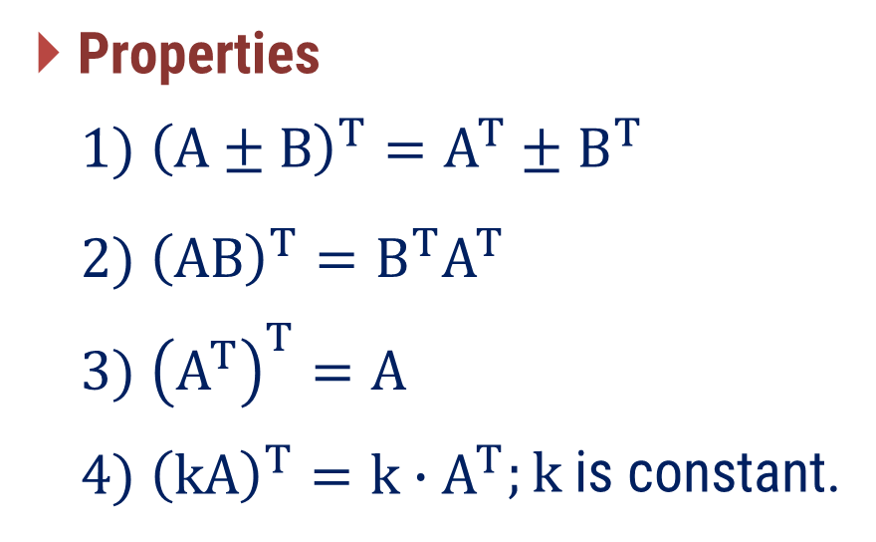
Remark
Every square matrix can be expressed as the sum of a symmetric and a skew-symmetric matrix as
$$A=\frac{1}{ 2 }\left( A+A^{T} \right)+\frac{1}{ 2 }\left( A−A^{T} \right)$$
Where, is a symmetric matrix and is a
$$P=\frac{1}{ 2 }\left( A+A^{T} \right)$$
$$Q=\frac{1}{ 2 }\left( A−A^{T} \right)$$
skew-symmetric matrix.
Now, ${P^{T}=\left[\frac{1}{ 2 }\left( A+A^{T} \right)\right]}^{T}=$
$$\frac{1}{ 2 }{\left( A+A^{T} \right)}^{T}$$
Proof:
$$= \frac{1}{ 2 }\left( A^{T}+{\left(A^{T}\right)}^{T} \right)$$

Slide 41
Remark
Proof(Continue):
$${\left[ \frac{1}{ 2 }\left( A+A^{T} \right) \right]}^{T}$$
$$=\frac{1}{ 2 }\left( A^{T}+{\left(A^{T}\right)}^{T} \right)$$
$$=\frac{1}{ 2 }\left( A^{T}+A \right)$$
$$=P$$
So, $P^{T}=P$
$$P=\frac{1}{ 2 }\left( A+A^{T} \right)$$
Hence, is a symmetric matrix.
$$Q=\frac{1}{ 2 }\left( A−A^{T} \right)$$
Similarly, we can prove that is a skew-symmetric matrix.

Slide 42
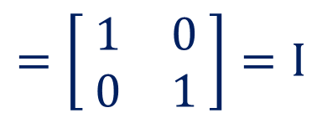
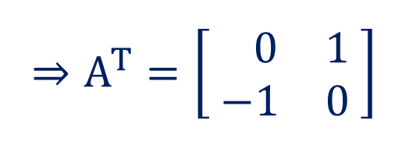
Orthogonal Matrix
A square matrix $A$ is known as an orthogonal matrix, if $AA^{T}=I=A^{T}A$.
Example:
$$A=\left[ \begin{matrix}0 & −1 \\ 1 & 0\end{matrix} \right]$$
$$⇒A^{T}=\left[ \begin{matrix} 0 & 1 \\ −1 & 0\end{matrix} \right]$$
$$\left[ \begin{matrix}0 & −1 \\ 1 & 0\end{matrix} \right]∙\left[ \begin{matrix} 0 & 1 \\ −1 & 0\end{matrix} \right]$$
  Now, $AA^{T}=$
$$=\left[ \begin{matrix}\left(0\right)\left(0\right)+\left(−1\right)\left(−1\right) & \left(0\right)\left(1\right)+\left(−1\right)\left(0\right) \\ \left(1\right)\left(0\right)+\left(0\right)\left(−1\right) & \left(1\right)\left(1\right)+\left(0\right)\left(0\right)\end{matrix} \right]$$
$$=\left[ \begin{matrix}1 & 0 \\ 0 & 1\end{matrix} \right]=I$$

Slide 43
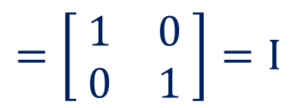
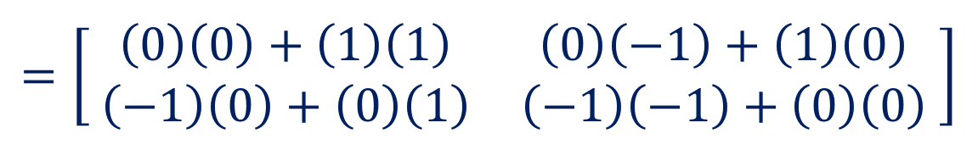

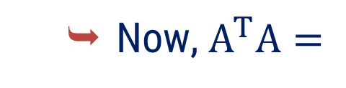
Orthogonal Matrix
A square matrix $A$ is known as an orthogonal matrix, if $AA^{T}=I=A^{T}A$.
Example:
$$A=\left[ \begin{matrix}0 & −1 \\ 1 & 0\end{matrix} \right]$$
$$⇒A^{T}=\left[ \begin{matrix} 0 & 1 \\ −1 & 0\end{matrix} \right]$$
$$\left[ \begin{matrix} 0 & 1 \\ −1 & 0\end{matrix} \right]∙\left[ \begin{matrix}0 & −1 \\ 1 & 0\end{matrix} \right]$$
  Now, $A^{T}A=$
$$=\left[ \begin{matrix}\left(0\right)\left(0\right)+\left(1\right)\left(1\right) & \left(0\right)\left(−1\right)+\left(1\right)\left(0\right) \\ \left(−1\right)\left(0\right)+\left(0\right)\left(1\right) & \left(−1\right)\left(−1\right)+\left(0\right)\left(0\right)\end{matrix} \right]$$
$$=\left[ \begin{matrix}1 & 0 \\ 0 & 1\end{matrix} \right]=I$$

Slide 44
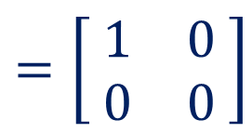
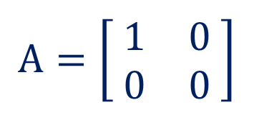
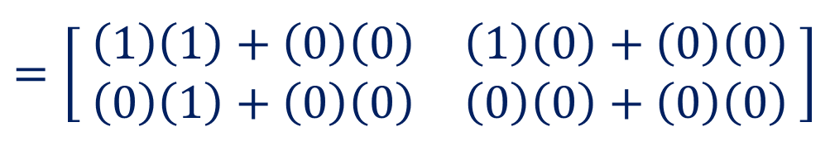



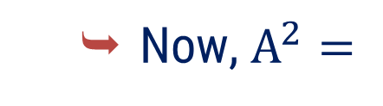

Idempotent Matrix
A square matrix $A$ is known as an idempotent matrix, if $A^{2}=A.$
Example:
$$A=\left[ \begin{matrix}1 & 0 \\ 0 & 0\end{matrix} \right]$$
$$\left[ \begin{matrix}1 & 0 \\ 0 & 0\end{matrix} \right]∙$$
$$\left[ \begin{matrix}1 & 0 \\ 0 & 0\end{matrix} \right]$$
  Now, $A^{2}=$
$$=\left[ \begin{matrix}\left(1\right)\left(1\right)+\left(0\right)\left(0\right) & \left(1\right)\left(0\right)+\left(0\right)\left(0\right) \\ \left(0\right)\left(1\right)+\left(0\right)\left(0\right) & \left(0\right)\left(0\right)+\left(0\right)\left(0\right)\end{matrix} \right]$$
$$=\left[ \begin{matrix}1 & 0 \\ 0 & 0\end{matrix} \right]$$
$$=A$$
$⇒A$ is an idempotent matrix.

Slide 45
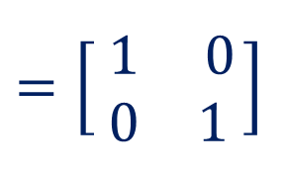
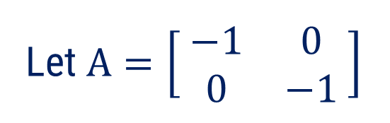
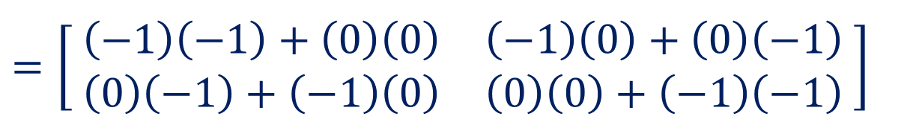
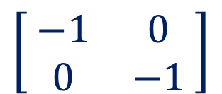
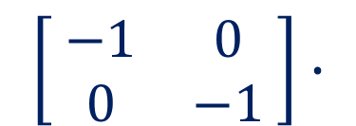

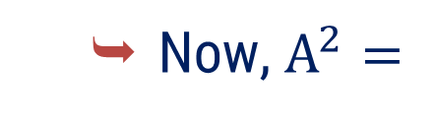

Involutory Matrix
A square matrix $A$ is known as an involutory matrix, if $A^{2}=I.$
Example:
Let $A=\left[ \begin{matrix}−1 & 0 \\ 0 & −1\end{matrix} \right]$
$$\left[ \begin{matrix}−1 & 0 \\ 0 & −1\end{matrix} \right]∙$$
$$\left[ \begin{matrix}−1 & 0 \\ 0 & −1\end{matrix} \right]$$
  Now, $A^{2}=$
$$=\left[ \begin{matrix}\left(−1\right)\left(−1\right)+\left(0\right)\left(0\right) & \left(−1\right)\left(0\right)+\left(0\right)\left(−1\right) \\ \left(0\right)\left(−1\right)+\left(−1\right)\left(0\right) & \left(0\right)\left(0\right)+\left(−1\right)\left(−1\right)\end{matrix} \right]$$
$$=\left[ \begin{matrix}1 & 0 \\ 0 & 1 \end{matrix}\right]$$
$$=I$$
$⇒A$ is an involutory matrix.

Slide 46
Method – 2
Determinant and Its Properties

Slide 47




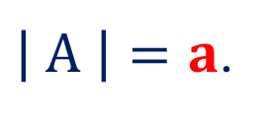

$$\text{Determinant} \text{of} \text{a} \text{Square} \text{M}\text{atrix}$$
The $\text{d}\text{eterminant} \text{of} \text{a} \text{square} \text{matrix} \text{A} \text{is} \text{denoted} \text{by} \left| A \right| or \det\left(A\right)$ or$∆.$
The $d\text{eterminant} \text{of} \text{matrix} A=\left[ a \right] \text{of} \text{order} 1×1 \text{is} \text{given} \text{by}$
$\left| A \right|=a$.
The $d\text{eterminant} \text{of} \text{matrix} A=\left[ \begin{matrix}a & b \\ c & d\end{matrix} \right]\text{of} \text{order} 2×2 \text{is} \text{given} \text{by}$
$\left| A \right|=ad−bc$.
The $d\text{eterminant} \text{of} \text{matrix} A=\left[ \begin{matrix}a & b & c \\ p & q & r \\ x & y & z\end{matrix} \right]\text{of} \text{order} 3×3 \text{is} \text{given} \text{by}$:
  $$\left| A \right|=a\left| \begin{matrix}q & r \\ y & z\end{matrix} \right|$$
  $$− b\left| \begin{matrix}p & r \\ x & z\end{matrix} \right|$$
  $$+ c\left| \begin{matrix}p & q \\ x & y\end{matrix} \right|$$

Slide 48
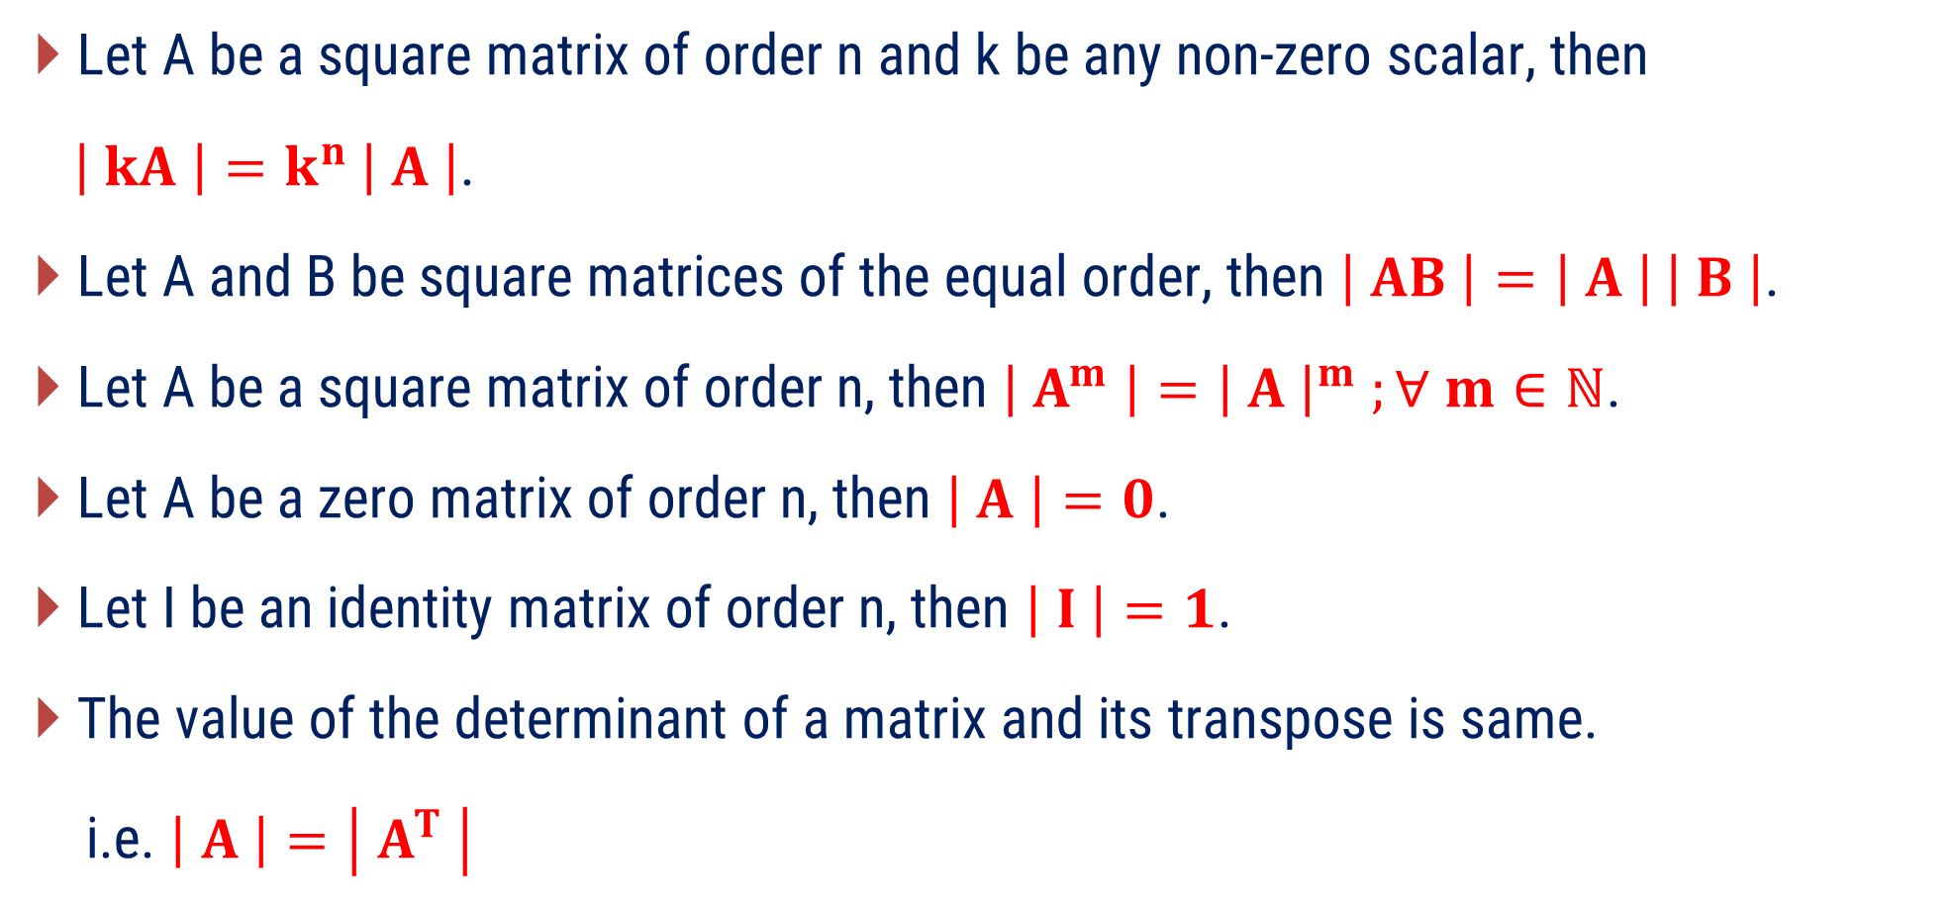
Properties of Determinant
Let A be a square matrix of order n and k be any non-zero scalar, then
$\left| kA \right|=k^{n} \left| A \right|$.
Let A and B be square matrices of the equal order, then $\left| AB \right|=\left| A \right| \left| B \right|\text{.}$
Let A be a square matrix of order n, then $\left| A^{m} \right|={\left| A \right|}^{m} ;∀ m∈ℕ$.
Let A be a zero matrix of order n, then $\left| A \right|=0$.
Let I be an identity matrix of order n, then $\left| I \right|=1$.
The value of the determinant of a matrix and its transpose is same.
i.e. $\left| A \right|=\left| A^{T} \right|$

Slide 49
Properties of Determinant
If each element in a row (or column) of a square matrix is zero, then the value of the determinant is zero.
If any two rows (or columns) of a square matrix are identical, then value of determinant is zero.
If any two rows (or columns) of a square matrix are interchanged, then sign of determinant changes by minus sign only.
If the given matrix is diagonal matrix OR upper (Lower) triangular matrix, then the value of the determinant is the product of the diagonal elements.

Slide 50
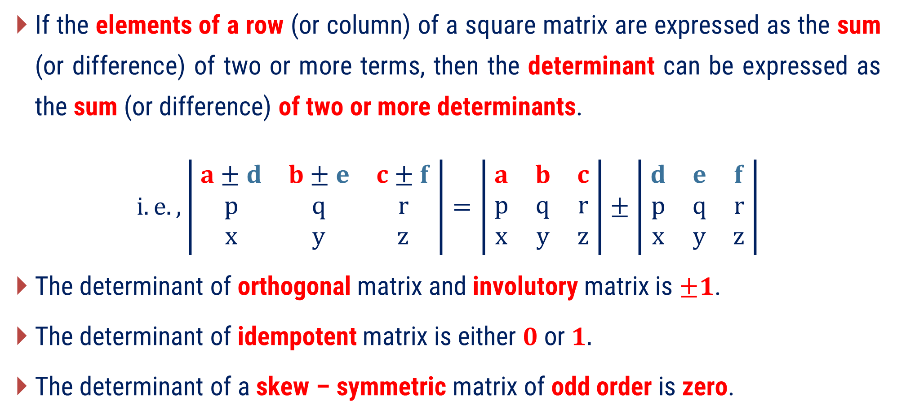
Properties of Determinant
If the elements of a row (or column) of a square matrix are expressed as the sum (or difference) of two or more terms, then the determinant can be expressed as the sum (or difference) of two or more determinants.
$$i.e., \left| \begin{matrix}a±d & b±e & c±f \\ p & q & r \\ x & y & z\end{matrix} \right|=\left| \begin{matrix}a & b & c \\ p & q & r \\ x & y & z\end{matrix} \right|±\left| \begin{matrix}d & e & f \\ p & q & r \\ x & y & z\end{matrix} \right|$$
The determinant of orthogonal matrix and involutory matrix is $±1$.
The determinant of idempotent matrix is either $0$or$1.$
The determinant of a skew – symmetric matrix of odd order is zero.

Slide 51









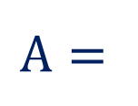














Elementary Row Operations
1) Interchange of any two rows
Notation:
$R_{ij}$OR $R_{i}↔R_{j}$; $i≠j$
Meaning:
Interchange of $i^{th}$ row and $j^{th}$ row
Example:
Equivalent
$$\left[ \begin{matrix}1 & 2 & 5 \\ 0 & 0 & −0 \\ 0 & −5 & \begin{aligned}0 \\ 0\end{aligned}\end{matrix} \right]$$
$$\sim \left[ \begin{matrix}1 & 2 & 5 \\ 0 & 0 & −0 \\ 0 & −5 & \begin{aligned}0 \\ 0\end{aligned}\end{matrix} \right]$$
$$1$$
$$−2$$
$$5$$
$$1$$
$$−2$$
$$5$$
$$A=$$
$$2$$
$$4$$
$$10$$
Applying $R_{13}$
$$2$$
$$4$$
$$10$$
$$0$$
$$3$$
$$−6$$
$$0$$
$$3$$
$$−6$$

Slide 52














Elementary Row Operations
2) Multiplication of any row by a non-zero scalar $k$
Notation:
$${k∙R}_{i}$$
Multiplication of all the elements of $i^{th}$ row by a non-zero scalar $k$
Meaning:
Example:
$$\left[ \begin{matrix}1 & 2 & 5 \\ 0 & 0 & −0 \\ 0 & −5 & \begin{aligned}0 \\ 0\end{aligned}\end{matrix} \right]$$
$$\sim \left[ \begin{matrix}1 & 2 & 5 \\ 0 & 0 & −0 \\ 0 & −5 & \begin{aligned}0 \\ 0\end{aligned}\end{matrix} \right]$$
$$1$$
$$−2$$
$$5$$
$$1$$
$$−2$$
$$5$$
$$A=$$
$$2$$
$$4$$
$$10$$
$$6$$
$$12$$
$$30$$
Applying ${3R}_{2}$
$$0$$
$$3$$
$$−6$$
$$0$$
$$3$$
$$−6$$

Slide 53









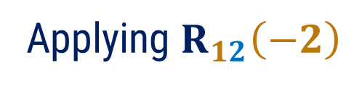


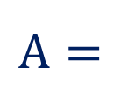























Elementary Row Operations
3) Add a multiple of one row to another row
Notation:
$R_{ij}\left(k\right)$ OR $R_{j}+k∙R_{i}$ ; $i≠j$
Meaning:
Multiplication of all the elements of $i^{th}$ row by a non-zero scalar $k$ and
add it into $j^{th}$ row.
Example:
$$\sim \left[ \begin{matrix}1 & 2 & 5 \\ 0 & 0 & −0 \\ 0 & −5 & \begin{aligned}0 \\ 0\end{aligned}\end{matrix} \right]$$
$$\left[ \begin{matrix}1 & 2 & 5 \\ 0 & 0 & −0 \\ 0 & −5 & \begin{aligned}0 \\ 0\end{aligned}\end{matrix} \right]$$
$$1$$
$$−2$$
$$5$$
$$1$$
$$−2$$
$$5$$
$$1$$
$$−2$$
$$5$$
$$A=$$
$$2$$
$$4$$
$$10$$
$$2$$
$$4$$
$$10$$
Applying $R_{12}\left(−2\right)$
$$0$$
$$3$$
$$−6$$
$$0$$
$$3$$
$$−6$$
$$×$$
$\left(−2\right)$
$$=$$
$$−2$$
$$4$$
$$−10$$
$$+$$
$$0$$
$$8$$
$$0$$

Slide 54
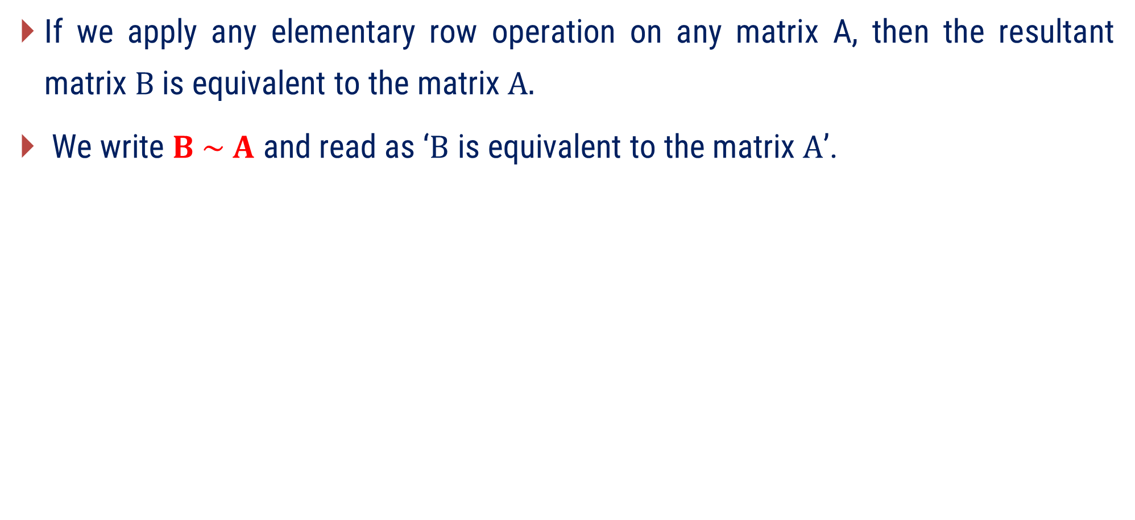
Elementary Row Operations
If we apply any elementary row operation on any matrix A, then the resultant matrix $B$is equivalent to the matrix $A.$
We write $B \sim A$ and read as ‘$B$ is equivalent to the matrix $A$’.

Slide 55
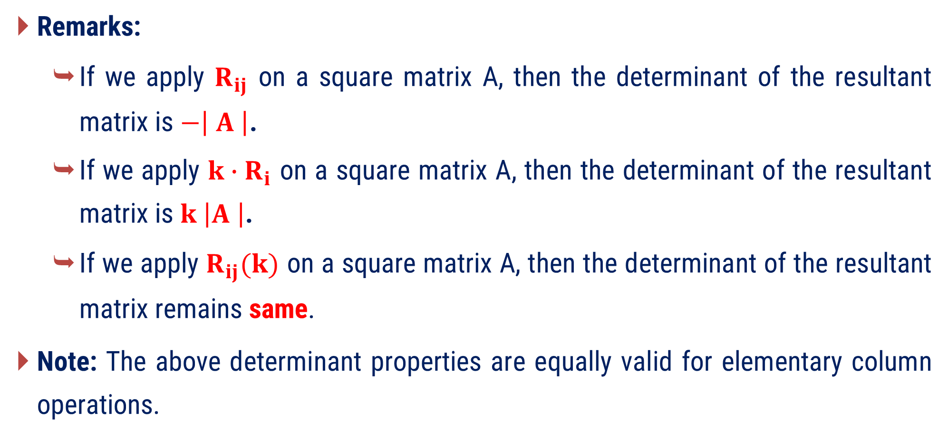
Elementary Row Operations
Remarks:
  If we apply $R_{ij}$ on a square matrix A, then the determinant of the resultant matrix is $−\left| A \right|$.
  If we apply ${k∙R}_{i}$ on a square matrix A, then the determinant of the resultant matrix is $k \left|A \right|$.
  If we apply $R_{ij}(k)$ on a square matrix A, then the determinant of the resultant matrix remains same.
Note: The above determinant properties are equally valid for elementary column operations.

Slide 56
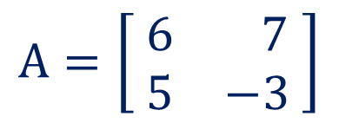

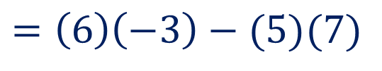
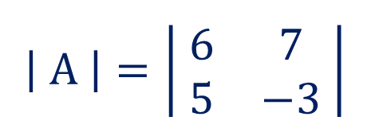
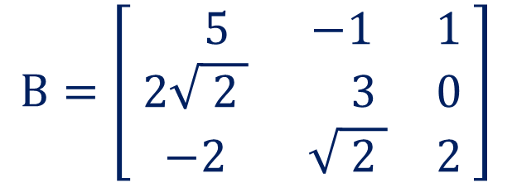
Method:2 $⇝$ Example:1
Example
Evaluate the determinant of following matrices.
$$B=\left[ \begin{matrix} 5 & −1 & 1 \\ 2\sqrt{ 2 } & 3 & 0 \\ −2 & \sqrt{ 2 } & 2\end{matrix} \right]$$
$$A=\left[ \begin{matrix}6 & 7 \\ 5 & −3\end{matrix} \right]$$
Solution
$$\left| A \right|=\left| \begin{matrix}6 & 7 \\ 5 & −3\end{matrix} \right|$$
$$=\left(6\right)\left(−3\right)−(5)(7)$$
$$=−53$$

Slide 57

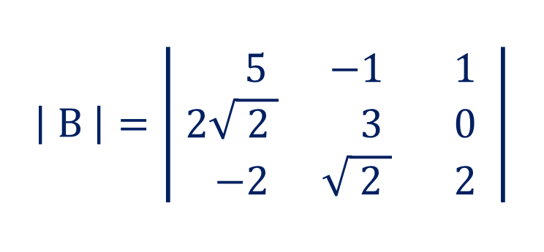
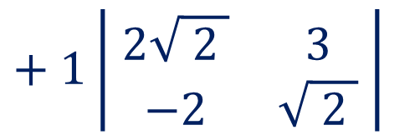
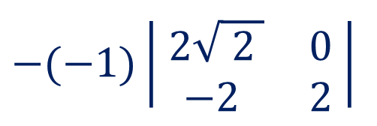
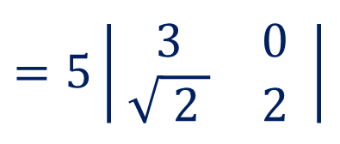

Method:2 $⇝$ Example:1(Continue)
$$\left| B \right|=\left| \begin{matrix} 5 & −1 & 1 \\ 2\sqrt{ 2 } & 3 & 0 \\ −2 & \sqrt{ 2 } & 2\end{matrix} \right|$$
  $$=5\left| \begin{matrix}3 & 0 \\ \sqrt{ 2 } & 2\end{matrix} \right|$$
  $$−(−1)\left|\begin{matrix} 2\sqrt{ 2 } & 0 \\ −2 & 2\end{matrix} \right|$$
  $$+ 1\left| \begin{matrix}2\sqrt{ 2 } & 3 \\ −2 & \sqrt{ 2 }\end{matrix} \right|$$
$=5\left(6−0\right)+1(4$ $\sqrt{ 2 }−0)+1(4+6)$
$$=30+4 \sqrt{ 2 }+10$$
$$=40+4 \sqrt{ 2 }$$

Slide 58



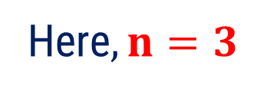



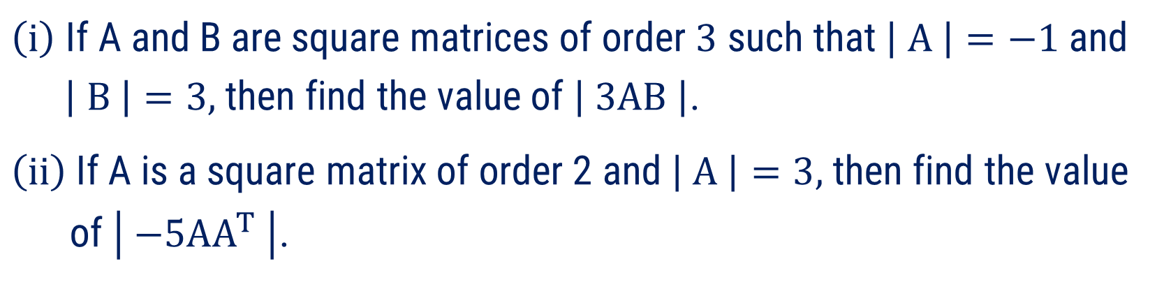



Method:2 $⇝$ Example:5
Example
$\left(i\right)$ If A and B are square matrices of order $3$ such that $\left| A \right|=−1$and
$\left| B \right|=3,$then find the value of $\left| 3AB \right|$.
$\left(ii\right)$If A is a square matrix of order 2 and $\left| A \right|=3,$then find the value
of $\left| −5AA^{T} \right|$.
Solution
( i ) For, $\left| 3AB \right|$
Since, $\left| AB \right|=\left| A \right| \left| B \right|$
Since, $\left| kA \right|={ k}^{n} \left| A \right|$
$$⇒ \left| 3AB \right|=3^{3} \left| A \right|\left| B \right|$$
Here$,n=3$
We have, $\left| A \right|=−1 \& \left| B \right|=3$
$$⇒\left| 3AB \right|$$
$$=3^{3} \left| AB \right|$$
$$⇒ \left| 3AB \right|=3^{3} \left(−1\right)\left(3\right)$$
$$⇒ \left| 3AB \right|=−81$$

Slide 59


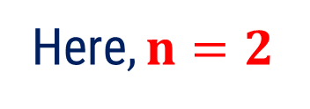


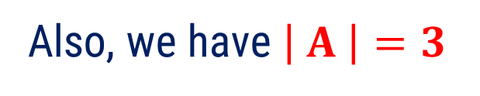





Method:2 $⇝$ Example:5(Continue)
Example
$\left(i\right)$ If A and B are square matrices of order $3$ such that $\left| A \right|=−1$and
$\left| B \right|=3,$then find the value of $\left| 3AB \right|$.
$\left(ii\right)$If A is a square matrix of order 2 and $\left| A \right|=3,$then find the value
of $\left| −5AA^{T} \right|$.
Solution
Since, $\left| AB \right|=\left| A \right| \left| B \right|$
( ii ) For, $\left| −5AA^{T}\right|$
$$⇒\left|−5AA^{T}\right|=25 \left| A \right|\left| A^{T} \right|$$
We apply $\left| kA \right|={ k}^{n} \left| A \right|$
Since, $\left| A \right|=\left| A^{T} \right|$
Here$,n=2$
Also, we have $\left| A \right|=3$
$$⇒\left|−5AA^{T}\right|$$
$$={\left(−5\right)}^{2} \left| AA^{T} \right|$$
$$⇒\left|−5AA^{T}\right|=25 \left(3\right)\left(3\right)$$
$$⇒\left|−5AA^{T}\right|=225$$

Slide 60
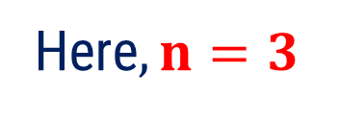
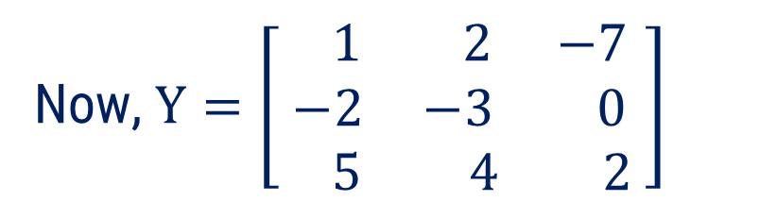

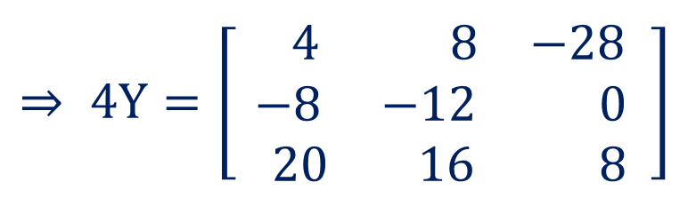
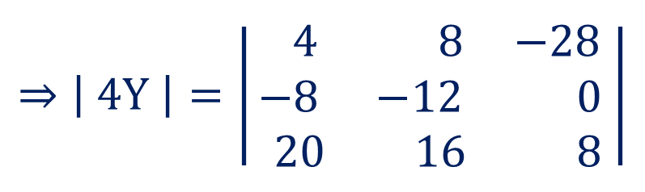
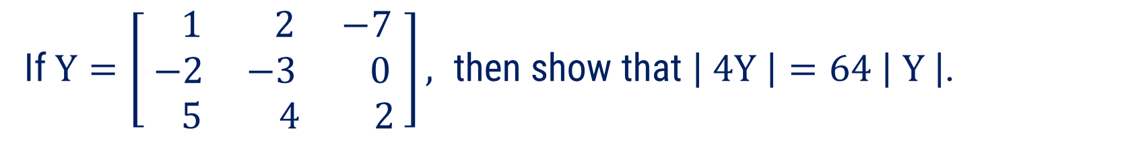
Method:2 $⇝$ Example:6
If $Y=\left[ \begin{matrix} 1 & 2 & −7 \\ −2 & −3 & 0 \\ 5 & 4 & 2\end{matrix} \right], \text{then} \text{show} \text{that} \left| 4Y \right|=64 \left| Y \right|$.
Example
Solution
Now, $Y=\left[ \begin{matrix} 1 & 2 & −7 \\ −2 & −3 & 0 \\ 5 & 4 & 2\end{matrix} \right]$
$$⇒\left| \text{4}Y \right|=\left|\begin{matrix} 4 & 8 & −28 \\ −8 & −12 & 0 \\ 20 & 16 & 8\end{matrix} \right|$$
$$⇒ \text{4}Y=\left[ \begin{matrix} 4 & 8 & −28 \\ −8 & −12 & 0 \\ 20 & 16 & 8\end{matrix} \right]$$
Since, $\left| kA \right|={ k}^{n} \left| A \right|$
Here$,n=3$

Slide 61
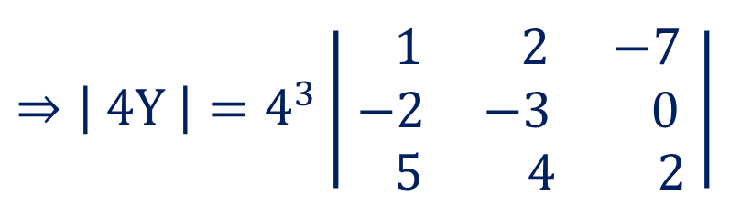

Method:2 $⇝$ Example:6(Continue)
$$⇒\left| \text{4}Y \right|=4^{3}\left| \begin{matrix} 1 & 2 & −7 \\ −2 & −3 & 0 \\ 5 & 4 & 2\end{matrix} \right|$$
$$⇒\left| \text{4}Y \right|=64 \left| Y \right|$$
Hence proved.

Slide 62



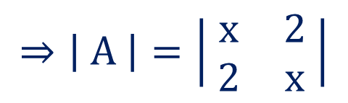

Method:2 $⇝$ Example:9
Example
If $A=\left[ \begin{matrix}x & 2 \\ 2 & x\end{matrix} \right]$and $\left| A^{4} \right|=625$, than find the real value(s) of $x$.
Solution
Now, $A=\left[ \begin{matrix}x & 2 \\ 2 & x\end{matrix} \right]$
$$⇒\left| A \right|=\left| \begin{matrix}x & 2 \\ 2 & x\end{matrix} \right|$$
$$⇒\left| A \right|=x^{2}−4$$
$$⇒{\left| A \right|}^{4}={\left( x^{2}−4 \right)}^{4}$$
Since, $\left| A^{m} \right|={\left| A \right|}^{m} ;∀ m∈ℕ$

Slide 63







Method:2 $⇝$ Example:9(Continue)
Example
If $A=\left[ \begin{matrix}x & 2 \\ 2 & x\end{matrix} \right]$and $\left| A^{4} \right|=625$, than find the real value(s) of $x$.
Solution
$$⇒\left| A^{4} \right|={\left( x^{2}−4 \right)}^{4}$$
$$⇒625={\left( x^{2}−4 \right)}^{4}$$
$$⇒25={\left( x^{2}−4 \right)}^{2}$$
OR
$$−25={\left( x^{2}−4 \right)}^{2}$$
$$⇒x^{2}−4=5$$
(which is not possible for real roots)
$$⇒x^{2}=9$$
$$⇒x=±3$$

Slide 64
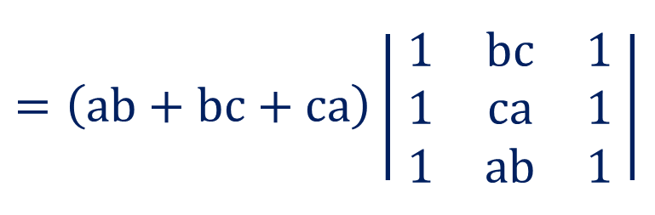
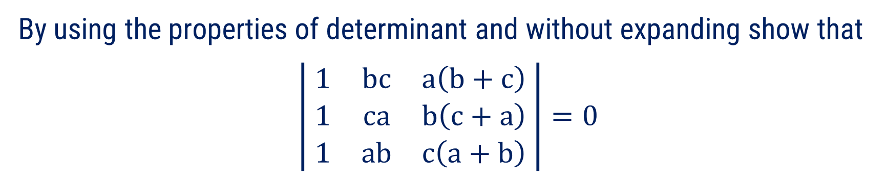

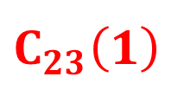
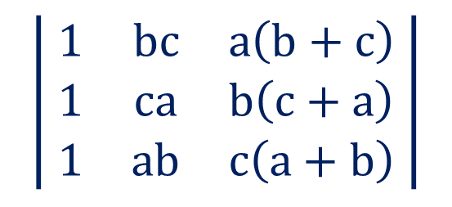

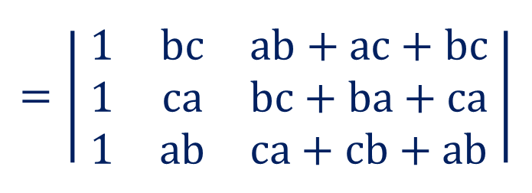
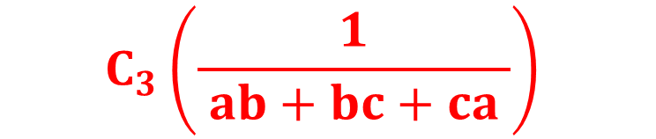
Method:2 $⇝$ Example:16
Example
By using the properties of determinant and without expanding show that
$$\left| \begin{matrix}1 & bc & a\left(b+c\right) \\ 1 & ca & b\left(c+a\right) \\ 1 & ab & c\left(a+b\right)\end{matrix} \right|=0$$
Solution
$$\left| \begin{matrix}1 & bc & a\left(b+c\right) \\ 1 & ca & b\left(c+a\right) \\ 1 & ab & c\left(a+b\right)\end{matrix} \right|$$
$$C_{3}\left(\frac{1}{ ab+bc+ca }\right)$$
$$=\left(ab+bc+ca\right)\left| \begin{matrix}1 & bc & 1 \\ 1 & ca & 1 \\ 1 & ab & 1\end{matrix} \right|$$
$$=\left| \begin{matrix}1 & bc & ab+ac+bc \\ 1 & ca & bc+ba+ca \\ 1 & ab & ca+cb+ab\end{matrix} \right|$$
$$C_{23}\left(1\right)$$
$$=0$$
$\left( ∵C_{1}=C_{3} \right)$

Slide 65





Method:2 $⇝$ Example:21
Without expanding, show that $\left| \begin{matrix}0 & b−a & c−a \\ a−b & 0 & c−b \\ a−c & b−c & 0\end{matrix} \right|=0$.
Example
Solution
$$\left| \begin{matrix}0 & b−a & c−a \\ a−b & 0 & c−b \\ a−c & b−c & 0\end{matrix} \right|$$
Note that, $a_{12}=b−a=−\left(a−b\right)=−a_{21}$
$$a_{13}=c−a=−\left(a−c\right)=−a_{31}$$
$$a_{23}=c−b=−\left(b−c\right)=−a_{32}$$

Slide 66


Method:2 $⇝$ Example:21(Continue)
$$\left| \begin{matrix}0 & b−a & c−a \\ a−b & 0 & c−b \\ a−c & b−c & 0\end{matrix} \right|$$
Also, diagonal entries are zero.
So, This is determinant of a skew-symmetric Matrix.
Since, the determinant of skew-symmetric matrix of odd order (3) is zero.
Hence, $\left| \begin{matrix}0 & b−a & c−a \\ a−b & 0 & c−b \\ a−c & b−c & 0\end{matrix} \right|=0$.

Slide 67









Method:2 $⇝$ Example:23
Example
By using properties of determinant, show that
$$\left| \begin{matrix}b+c & q+r & y+z \\ c+a & r+p & z+x \\ a+b & p+q & x+y\end{matrix} \right|=2\left| \begin{matrix}a & p & x \\ b & q & y \\ c & r & z\end{matrix} \right|$$
Solution
( Separated elements of 1st row )
$$\left| \begin{matrix}b+c & q+r & y+z \\ c+a & r+p & z+x \\ a+b & p+q & x+y\end{matrix} \right|$$
$$=\left| \begin{matrix}b & q & y \\ c+a & r+p & z+x \\ a+b & p+q & x+y\end{matrix} \right|+\left| \begin{matrix}bc & r & z \\ c+a & r+p & z+x \\ a+b & p+q & x+y\end{matrix} \right|$$
$$=\left| \begin{matrix} & & \\ c+a & r+p & z+x \\ a+b & p+q & x+y\end{matrix} \right|+\left| \begin{matrix} & & \\ c+a & r+p & z+x \\ a+b & p+q & x+y\end{matrix} \right|$$
$$R_{13}\left(−1\right)$$
$$R_{12}\left(−1\right)$$
$$=\left| \begin{matrix}b & q & y \\ c+a & r+p & z+x \\ a & p & x\end{matrix} \right|$$
$$+\left| \begin{matrix}c & r & z \\ a & p & x \\ a+b & p+q & x+y\end{matrix} \right|$$

Slide 68











Method:2 $⇝$ Example:23(Continue)
$$=\left| \begin{matrix}b & q & y \\ c+a & r+p & z+x \\ a & p & x\end{matrix} \right|+\left| \begin{matrix}c & r & z \\ a & p & x \\ a+b & p+q & x+y\end{matrix} \right|$$
$$R_{32}\left(−1\right)$$
$$R_{23}\left(−1\right)$$
$$= \left| \begin{matrix}b & q & y \\ c & r & z \\ a & p & x\end{matrix} \right|$$
$$\left| \begin{matrix}c & r & z \\ a & p & x \\ b & q & y\end{matrix} \right|$$
$$+$$
$$R_{12}$$
$$R_{12}$$
$$= −\left| \begin{matrix}c & r & z \\ b & q & y \\ a & p & x\end{matrix} \right|$$
$$\left| \begin{matrix}a & p & x \\ c & r & z \\ b & q & y\end{matrix} \right|$$
$$−$$

Slide 69






Method:2 $⇝$ Example:23(Continue)
$$=−\left| \begin{matrix}c & r & z \\ b & q & y \\ a & p & x\end{matrix} \right|−\left| \begin{matrix}a & p & x \\ c & r & z \\ b & q & y\end{matrix} \right|$$
$$R_{13}$$
$$R_{23}$$
$$=\left| \begin{matrix}a & p & x \\ b & q & y \\ c & r & z\end{matrix} \right|$$
$$+ \left| \begin{matrix}a & p & x \\ b & q & y \\ c & r & z\end{matrix} \right|$$
$$=2\left| \begin{matrix}a & p & x \\ b & q & y \\ c & r & z\end{matrix} \right|$$
Hence proved.

Slide 70




Method:2 $⇝$ Example:26
Example
By using the properties of determinant, show that
$$\left| \begin{matrix}1 & b & b^{2} \\ 1 & c & c^{2} \\ 1 & a & a^{2}\end{matrix} \right|=\left(a−b\right)\left(b−c\right)\left(c−a\right)$$
Solution
$$\left| \begin{matrix}1 & b & b^{2} \\ 1 & c & c^{2} \\ 1 & a & a^{2}\end{matrix} \right|$$
$$=\left| \begin{matrix}0 & b−a & b^{2}−a^{2} \\ 0 & c−a & c^{2}−a^{2} \\ 1 & a & a^{2}\end{matrix} \right|$$
$$\begin{aligned} \\ R_{31}\left(−1\right) \\ and \\ &R_{32}\left(−1\right)\end{aligned}$$

Slide 71







Method:2 $⇝$ Example:26(Continue)
$$=\left| \begin{matrix}0 & b−a & b^{2}−a^{2} \\ 0 & c−a & c^{2}−a^{2} \\ 1 & a & a^{2}\end{matrix} \right|$$
$$=\left| \begin{matrix}0 & b−a & \left(b−a\right)\left(b+a\right) \\ 0 & c−a & \left(c−a\right)\left(c+a\right) \\ 1 & a & a^{2}\end{matrix} \right|$$
$$R_{1}\left(\frac{1}{ b−a }\right) and { R}_{2}\left(\frac{1}{ c−a }\right)$$
$$=\left(b−a\right)\left(c−a\right)\left| \begin{matrix}0 & 1 & b+a \\ 0 & 1 & c+a \\ 1 & a & a^{2}\end{matrix} \right|$$
$\left(\begin{aligned}Solving the \\ determinant\end{aligned}\right)$
$$=\left(b−a\right)\left(c−a\right)\left[\left(c+a\right)−\left(b+a\right)\right]$$
$$=\left(b−a\right)\left(c−a\right)\left(c−b\right)$$
$$=\left(a−b\right)\left(c−a\right)\left(b−c\right)$$

Slide 72










Method:2 $⇝$ Example:31
Example
Prove below statements.
  Determinant of orthogonal matrix is $±1$.
  Determinant of idempotent matrix is either $0 or 1.$
  Determinant of involutory matrix is $±1$.
  Determinant of a skew – symmetric matrix of odd order is zero.
Solution
  Determinant of orthogonal matrix is $±1$.
  Let $A$ be an orthogonal matrix.
  i.e. $A A^{T}=I$
  $$⇒\left| A A^{T} \right|=\left| I \right|$$
  $$⇒\left| A \right|\left| A^{T} \right|=1$$
$$∵\left| AB \right|=\left| A \right|\left| B \right|$$
  $$⇒{\left| A \right|}^{2}=1$$
$$∵\left| A \right|=\left| A^{T} \right|$$
  $$⇒\left| A \right|=±1$$

Slide 73








Method:2 $⇝$ Example:31(Continue)
Solution
  Determinant of idempotent matrix is either $0 or 1.$
  Let $A$ be an idempotent matrix.
  i.e. $A^{2}=A$
  $$⇒\left| A^{2} \right|=\left| A \right|$$
  $$⇒{\left| A \right|}^{2}=\left| A \right|$$
$$∵\left| A^{m} \right|={\left| A \right|}^{m} ; ∀ m∈ℕ$$
  $$⇒{\left| A \right|}^{2}−\left| A \right|=0$$
  $$⇒\left| A \right|\left(\left| A \right|−1\right)=0$$
  $⇒\left| A \right|=0$OR$1$

Slide 74






Method:2 $⇝$ Example:31(Continue)
Solution
  Determinant of involutory matrix is $±1$.
  Let $A$ be an involutory matrix.
  i.e. $A^{2}=I$
  $$⇒\left| A^{2} \right|=\left| A \right|$$
  $$⇒{\left| A \right|}^{2}=1$$
  $$⇒\left| A \right|=± 1$$

Slide 75








Method:2 $⇝$ Example:31(Continue)
Solution
  Determinant of a skew – symmetric matrix of odd order is zero.
  Let $A$ be an a skew – symmetric matrix of odd order.
  i.e. $A^{T}=− A$
  $$⇒\left| A^{T} \right|=\left| −A \right|$$
  $$⇒\left| A^{T} \right|={\left(−1\right)}^{n} \left| A \right|$$
$\text{Since}\text{, }\left| kA \right|={ k}^{n} \left| A \right|$ ; Taking $k=\left(−1\right)$
  $$⇒\left| A \right|=−\left| A \right|$$
$$∵\left| A \right|=\left| A^{T} \right| ;n is odd$$
  $$⇒2\left| A \right|=0$$
  $$⇒\left| A \right|=0$$

Slide 76
Method – 3
Echelon Forms and Rank of a Matrix

Slide 77

Definitions
Zero Row : A row in which all the elements are zero is known as zero row.
  Example:
  For $A=\left[ \begin{matrix}1 & −2 & −6 \\ 0 & 0 & 0 \\ 6 & −8 & 9\end{matrix} \right]\text{second} \text{row} \text{is} \text{zero} \text{row}\text{.}$

Slide 78

Definitions
Leading/Pivot Element : The first non-zero element of any row is known as leading element of that row.
  Example:
  For $A=\left[ \begin{matrix}0 & −2 & 3 \\ 1 & 0 & 4 \\ 0 & 0 & 9\end{matrix} \right]$
    The leading element of $1^{st}$ row is $−2$
    The leading element of $2^{nd}$ row is $1$
    The leading element of $3^{rd}$ row is $9$

Slide 79














Notations and Definitions
Order of a row: Order of a row is the number of elements in that row starting from the leading element.
  Example:
$$\left[ \begin{matrix}1 & 2 & 5 \\ 0 & 0 & −0 \\ 0 & −5 & \begin{aligned}0 \\ 0\end{aligned}\end{matrix} \right]$$
$$0$$
$$−2$$
$$5$$
Order$=2$
$$A=$$
$$1$$
$$0$$
$$4$$
Order$=3$
$$0$$
$$0$$
$$6$$
Order$=1$

Slide 80
Procedure to Convert the Matrix into a Row - Echelon Form
1
Put all the zero rows at the bottom of the matrix.
2
Arrange all the rows of the matrix in decreasing order.
Select the highest order row whose leading element has some non-zero elements below it, and make them zero by using the leading element.
3
4
Repeat the steps above.
Note: Row-Echelon form of a matrix is not unique.

Slide 81









































Row - Echelon Form
$\left[\begin{matrix}0 & 0 & 0 & 0 \\ 6 & 2 & −4 & 3 \\ 0 & 4 & 1 & 0 \\ 0 & 5 & \begin{aligned}0 \\ \\ \end{aligned} & 1\end{matrix}\right]$
$$0$$
$$0$$
$$0$$
$$0$$
$$6$$
$$2$$
$$−4$$
$$3$$
$$A =$$
For matrix
$$0$$
$$4$$
$$1$$
$$0$$
$$0$$
$$5$$
$$0$$
$$1$$
$\left[ \begin{matrix}0 & 0 & 0 & 0 \\ 6 & 2 & −4 & 3 \\ 0 & 4 & 1 & 0 \\ 0 & 5 & \begin{aligned}0 \\ \\ \end{aligned} & \begin{aligned} \\ \\ \\ 1\end{aligned}\end{matrix}\right]$
$$6$$
$$2$$
$$−4$$
$$3$$
Order$=4$
$$0$$
$$5$$
$$0$$
$$1$$
Order$=3$
Row Echelon Form is
$$−\frac{4}{ 5 }$$
$$0$$
$$0$$
$$1$$
Order$=2$
$$0$$
$$0$$
$$0$$
$$0$$
Order$=0$

Slide 82


Row - Echelon Form
What is the meaning of the word “Echelon” ?
“Echelon” is a military term that refers to a specific type of formation of troops,
ships, airplanes, etc.
Image Resource: http://opening.download/spring-2021.html

Slide 83


Row - Echelon Form
What is the meaning of the word “Echelon” ?
In Echelon formation, each member of the formation is positioned behind and to
the right (or left) of the member ahead.
Image Resource: http://opening.download/spring-2021.html

Slide 84














































Method:3 $⇝$ Example:1
$$1$$
$$2$$
$$0$$
$$3$$
Example
Convert the matrix
$$A=$$
$$0$$
$$−4$$
$$5$$
$$2$$
into row-echelon form.
$$2$$
$$3$$
$$1$$
$$6$$
$$1$$
$$2$$
$$0$$
$$3$$
$$4$$
Solution
$$A=$$
$$0$$
$$−4$$
$$5$$
$$2$$
$$0$$
$$−4$$
$$5$$
$$2$$
$$3$$
$$2$$
$$3$$
$$1$$
$$6$$
$$2$$
$$3$$
$$1$$
$$6$$
$$4$$
$$1$$
$$2$$
$$0$$
$$3$$
$$\sim$$
$$R_{23}$$

Slide 85





























































Method:3 ⇝ Example:1(Continue)
$$1$$
$$2$$
$$0$$
$$3$$
$$1$$
$$2$$
$$0$$
$$3$$
$$×$$
$$\left(−2\right)$$
$$\sim$$
$$2$$
$$2$$
$$3$$
$$1$$
$$6$$
$$3$$
$$1$$
$$6$$
$$=$$
$$−2$$
$$−4$$
$$0$$
$$−6$$
$$0$$
$$−4$$
$$5$$
$$2$$
$$+$$
$$1$$
$$2$$
$$0$$
$$3$$
$$0$$
$$−1$$
$$1$$
$$0$$
$$\sim$$
$$R_{12}(−2)$$
$$0$$
$$−4$$
$$5$$
$$2$$
Which is a row
echelon form
of matrix $A$.
$$1$$
$$2$$
$$0$$
$$3$$
$$\sim$$
$$0$$
$$−1$$
$$1$$
$$0$$
$$R_{23}(−4)$$
$$0$$
$$0$$
$$1$$
$$2$$

Slide 86
Procedure to Convert the Matrix into Reduced Row - Echelon Form
1
Put all the zero rows at the bottom of the matrix.
2
Arrange all the rows of a matrix in the decreasing order.
Select the top row of highest order and make its leading element 1, if not.
3

Slide 87
Procedure to Convert Matrix into Reduced Row - Echelon Form
4
By using that leading element of the selected row, make all entries above and below it equal to 0.
5
Repeat the steps for the next higher order row.
Note: Reduced row - echelon form of any matrix is unique.

Slide 88












































Reduced Row - Echelon Form
$\left[\begin{matrix}0 & 0 & 0 & 0 & \\ 6 & 2 & −4 & 3 & \\ 0 & 4 & 1 & 0 & \\ 0 & 5 & \begin{aligned}0 \\ \\ \end{aligned} & 1 & \end{matrix}\right]$
$$0$$
$$2$$
$$2$$
$$6$$
$$4$$
$$0$$
$$1$$
$$0$$
$$4$$
$$2$$
For matrix $A =$
$$0$$
$$0$$
$$0$$
$$0$$
$$4$$
$$0$$
$$0$$
$$0$$
$$1$$
$$3$$
$\left[\begin{matrix}0 & 0 & 0 & 0 & \\ 6 & 2 & −4 & 3 & \\ 0 & 4 & 1 & 0 & \\ 0 & 5 & \begin{aligned}0 \\ \\ \end{aligned} & 1 & \end{matrix}\right]$
$$0$$
$$1$$
$$0$$
$$0$$
$$0$$
$$0$$
$$0$$
$$1$$
$$0$$
$$0$$
Reduced Row Echelon Form is $A =$
$$0$$
$$0$$
$$0$$
$$1$$
$$0$$
$$0$$
$$0$$
$$0$$
$$0$$
$$1$$

Slide 89





































Method:3 $⇝$ Example:6
$\left[\begin{matrix}0 & 0 & 0 & 0 \\ 6 & 2 & −4 & 3 \\ 0 & 4 & 1 & 0 \\ 0 & 5 & \begin{aligned}0 \\ \\ \end{aligned} & 1\end{matrix}\right]$
$$2$$
$$4$$
$$3$$
$$4$$
$$1$$
$$2$$
$$1$$
$$3$$
Example
Convert the matrix
into reduced row-echelon form.
$$1$$
$$3$$
$$2$$
$$2$$
$$3$$
$$7$$
$$4$$
$$8$$
Solution
$\left[\begin{matrix} & 0 & 0 & 0 \\ & 2 & −4 & 3 \\ 0 & 4 & 1 & 0 \\ 0 & 5 & \begin{aligned}0 \\ \\ \end{aligned} & 1\end{matrix}\right]$
$\left[\begin{matrix}0 & 0 & 0 & 0 \\ 6 & 2 & −4 & 3 \\ 0 & 4 & 1 & 0 \\ 0 & 5 & \begin{aligned}0 \\ \\ \end{aligned} & 1\end{matrix}\right]$
$$2$$
$$4$$
$$3$$
$$4$$
$$1$$
$$2$$
$$1$$
$$3$$
$$1$$
$$2$$
$$1$$
$$3$$
$$2$$
$$4$$
$$3$$
$$4$$
$$A=$$
$$\sim$$
$$R_{21}$$
$$1$$
$$3$$
$$2$$
$$2$$
$$1$$
$$3$$
$$2$$
$$2$$
$$3$$
$$7$$
$$4$$
$$8$$
$$3$$
$$7$$
$$4$$
$$8$$

Slide 90













































































Method:3 ⇝ Example:6(Continue)
$\left[\begin{matrix}0 & 0 & 0 & 0 \\ 6 & 2 & −4 & 3 \\ 0 & 4 & 1 & 0 \\ 0 & 5 & \begin{aligned}0 \\ \\ \end{aligned} & 1\end{matrix}\right]$
$$1$$
$$2$$
$$1$$
$$3$$
$$R_{34}\left(−1\right)$$
$$2$$
$$4$$
$$3$$
$$4$$
$\left[\begin{matrix}0 & 0 & 0 & 0 \\ 6 & 2 & −4 & 3 \\ 0 & 4 & 1 & 0 \\ 0 & 5 & \begin{aligned}0 \\ \\ \end{aligned} & 1\end{matrix}\right]$
$$1$$
$$2$$
$$1$$
$$3$$
$$\sim$$
$$1$$
$$3$$
$$2$$
$$2$$
$$0$$
$$0$$
$$1$$
$$−2$$
$$0$$
$$0$$
$$1$$
$$−2$$
$$\sim$$
$$3$$
$$7$$
$$4$$
$$8$$
$$0$$
$$1$$
$$1$$
$$−1$$
$$0$$
$$1$$
$$1$$
$$−1$$
$$0$$
$$0$$
$$0$$
$$0$$
$$R_{12}\left(−2\right),$$
$$R_{13}\left(−1\right),$$
$$R_{14}\left(−3\right)$$
$$R_{23}$$
$\left[\begin{matrix}0 & 0 & 0 & 0 \\ 6 & 2 & −4 & 3 \\ 0 & 4 & 1 & 0 \\ 0 & 5 & \begin{aligned}0 \\ \\ \end{aligned} & 1\end{matrix}\right]$
$\left[\begin{matrix}0 & 0 & 0 & 0 \\ 6 & 2 & −4 & 3 \\ 0 & 4 & 1 & 0 \\ 0 & 5 & \begin{aligned}0 \\ \\ \end{aligned} & 1\end{matrix}\right]$
$$1$$
$$2$$
$$1$$
$$3$$
$$1$$
$$2$$
$$1$$
$$3$$
$$0$$
$$0$$
$$1$$
$$−2$$
$$\sim$$
$$\sim$$
$$0$$
$$1$$
$$1$$
$$−1$$
Same Row
$$0$$
$$1$$
$$1$$
$$−1$$
$$0$$
$$0$$
$$0$$
$$0$$

Slide 91


























































Method:3 ⇝ Example:6(Continue)
$\left[\begin{matrix}0 & 0 & 0 & 0 \\ 6 & 2 & −4 & 3 \\ 0 & 4 & 1 & 0 \\ 0 & 5 & \begin{aligned}0 \\ \\ \end{aligned} & 1\end{matrix}\right]$
$$R_{32}\left(−1\right),$$
$$R_{31}(1)$$
$$1$$
$$2$$
$$1$$
$$3$$
$\left[\begin{matrix}0 & 0 & 0 & 0 \\ 6 & 2 & −4 & 3 \\ 0 & 4 & 1 & 0 \\ 0 & 5 & \begin{aligned}0 \\ \\ \end{aligned} & 1\end{matrix}\right]$
$$1$$
$$0$$
$$0$$
$$3$$
$$0$$
$$1$$
$$1$$
$$−1$$
$$\sim$$
$$0$$
$$1$$
$$0$$
$$1$$
$$0$$
$$0$$
$$1$$
$$−2$$
$$\sim$$
$$0$$
$$0$$
$$1$$
$$−2$$
$$0$$
$$0$$
$$0$$
$$0$$
$$0$$
$$0$$
$$0$$
$$0$$
$$R_{21}(−2)$$
$\left[\begin{matrix}0 & 0 & 0 & 0 \\ 6 & 2 & −4 & 3 \\ 0 & 4 & 1 & 0 \\ 0 & 5 & \begin{aligned}0 \\ \\ \end{aligned} & 1\end{matrix}\right]$
$$1$$
$$0$$
$$−1$$
$$5$$
Which is reduced row
echelon form
of matrix $A$.
$$0$$
$$1$$
$$1$$
$$−1$$
$$\sim$$
$$0$$
$$0$$
$$1$$
$$−2$$
$$0$$
$$0$$
$$0$$
$$0$$

Slide 92
Difference between Row - Echelon and Reduced Row - Echelon Form
Row - Echelon Form
Reduced Row - Echelon Form
The leading entries can be anything.
The leading entries must be 1(one).
Make all the entries zero below the
Make all the entries zero below and
leading element of each row.
above leading element of each row.
Row echelon form is not unique.
Reduced Row echelon form is unique.

Slide 93

Method:3 $⇝$ Example:10
Example
Determine whether the following matrices are row-echelon form OR
reduced row-echelon form OR both OR none.
$$A=\left[ \begin{matrix}0 & 2 & 6 \\ 0 & 0 & 0 \\ 0 & 0 & 8\end{matrix} \right]$$
Answer
None
Reason
In given matrix zero row is not at
the bottom of the matrix.
Reduced Row-Echelon Form
Row-Echelon Form
Reduced
Zero row
at the bottom
Decreasing
Order
Zero below
leading entry
Leading Entry
1
Zero above
leading entry

Slide 94


Method:3 ⇝ Example:10(Continue)
Example
Determine whether the following matrices are row-echelon form OR
reduced row-echelon form OR both OR none.
$$B=\left[ \begin{matrix}0 & 4 & 6 & 5 \\ 6 & 0 & 8 & 3 \\ 0 & 0 & 5 & 7\end{matrix} \right]$$
Answer
None
Reason
Rows of matrix $B$ are not in decreasing order.
Reduced Row-Echelon Form
Row-Echelon Form
Reduced
Zero row
at the bottom
Decreasing
Order
Zero below
leading entry
Leading Entry
1
Zero above
leading entry

Slide 95


Method:3 ⇝ Example:10(Continue)
Example
Determine whether the following matrices are row-echelon form OR
reduced row-echelon form OR both OR none.
$$C=\left[ \begin{matrix}2 & 6 \\ 0 & 5 \\ 0 & 3\end{matrix} \right]$$
Answer
None
Reason
There is no zero below the leading entry of
$2^{nd}$ row.
Reduced Row-Echelon Form
Row-Echelon Form
Reduced
Zero row
at the bottom
Decreasing
Order
Zero below
leading entry
Leading Entry
1
Zero above
leading entry

Slide 96


Method:3 ⇝ Example:10(Continue)
Example
Determine whether the following matrices are row-echelon form OR
reduced row-echelon form OR both OR none.
$$D=\left[ \begin{matrix}0 & 4 \\ 0 & 0 \\ 0 & 0\end{matrix} \right]$$
Answer
Row - echelon form
Reason
Not reduced row-echelon form because the
leading entry of first row is not $1.$
Reduced Row-Echelon Form
Row-Echelon Form
Reduced
Zero row
at the bottom
Decreasing
Order
Zero below
leading entry
Leading Entry
1
Zero above
leading entry

Slide 97

Method:3 ⇝ Example:10(Continue)
Example
Determine whether the following matrices are row-echelon form OR
reduced row-echelon form OR both OR none.
$$E=\left[ \begin{matrix}5 & −4 & 6 & 5 \\ 0 & 0 & 8 & 3 \\ 0 & 0 & 0 & 7\end{matrix} \right]$$
Answer
Row - echelon form
Reason
Not reduced row-echelon form because
leading entry of first row is not 1.
Reduced Row-Echelon Form
Row-Echelon Form
Reduced
Zero row
at the bottom
Decreasing
Order
Zero below
leading entry
Leading Entry
1
Zero above
leading entry

Slide 98

Method:3 ⇝ Example:10(Continue)
Example
Determine whether the following matrices are row-echelon form OR
reduced row-echelon form OR both OR none.
$$F=\left[ \begin{matrix}1 & 2 & 0 \\ 0 & 1 & 0 \\ 0 & 0 & 0\end{matrix} \right]$$
Answer
Row - echelon form
Reason
Not reduced row-echelon form because
there is no zero above the leading entry of
second row.
Reduced Row-Echelon Form
Row-Echelon Form
Reduced
Zero row
at the bottom
Decreasing
Order
Zero below
leading entry
Leading Entry
1
Zero above
leading entry

Slide 99


Method:3 ⇝ Example:10(Continue)
Example
Determine whether the following matrices are row-echelon form OR
reduced row-echelon form OR both OR none.
$$G=\left[ 6 \right]$$
Answer
Row - echelon form
Reason
Not reduced row-echelon form because
the leading entry is not $1.$
Reduced Row-Echelon Form
Row-Echelon Form
Reduced
Zero row
at the bottom
Decreasing
Order
Zero below
leading entry
Leading Entry
1
Zero above
leading entry

Slide 100


Method:3 ⇝ Example:10(Continue)
Example
Determine whether the following matrices are row-echelon form OR
reduced row-echelon form OR both OR none.
$$H=\left[ \begin{matrix}3 & 2\end{matrix} \right]$$
Answer
Row echelon form
Reason
Not reduced row-echelon form because
the leading entry is not $1.$
Reduced Row-Echelon Form
Row-Echelon Form
Reduced
Zero row
at the bottom
Decreasing
Order
Zero below
leading entry
Leading Entry
1
Zero above
leading entry

Slide 101


Method:3 ⇝ Example:10(Continue)
Example
Determine whether the following matrices are row-echelon form OR
reduced row-echelon form OR both OR none.
$$I=\left[ \begin{matrix}1 & 0 & 0 & 0 \\ 0 & 1 & 0 & 0 \\ 0 & 0 & 1 & 0\end{matrix} \right]$$
Answer
Both
Reason
Matrix $I$ satisfies all the condition of reduced
row - echelon form.
Reduced Row-Echelon Form
Row-Echelon Form
Reduced
Zero row
at the bottom
Decreasing
Order
Zero below
leading entry
Leading Entry
1
Zero above
leading entry

Slide 102


Method:3 ⇝ Example:10(Continue)
Example
Determine whether the following matrices are row-echelon form OR
reduced row-echelon form OR both OR none.
$$J=\left[ \begin{matrix}0 & 0 \\ 0 & 0 \\ 0 & 0\end{matrix} \right]$$
Answer
Both
Reason
Matrix $J$ satisfies all the condition of reduced
Row - echelon form.
Reduced Row-Echelon Form
Row-Echelon Form
Reduced
Zero row
at the bottom
Decreasing
Order
Zero below
leading entry
Leading Entry
1
Zero above
leading entry

Slide 103


Method:3 ⇝ Example:10(Continue)
Example
Determine whether the following matrices are row-echelon form OR
reduced row-echelon form OR both OR none.
$$K=\left[ \begin{matrix}1 & 2\end{matrix} \right]$$
Answer
Both
Reason
Matrix $K$ satisfies all the condition of reduced
row - echelon form.
Reduced Row-Echelon Form
Row-Echelon Form
Reduced
Zero row
at the bottom
Decreasing
Order
Zero below
leading entry
Leading Entry
1
Zero above
leading entry

Slide 104

Minor of a Matrix
Let $A$ be an $m×n$ matrix.
  Determinant of any square submatrix of a given matrix $A$is called a minor of $A$.
  If the square submatrix is of order $r$, then it’s minor is also of order $r$.

Slide 105

Rank of a Matrix
Let $A$ be an $m×n$ matrix. Then the non-negative integer $r$ is known as the rank of $A$ if
(1) There is at least one minor of order $r$, which is non-zero, and
(2) Every minor of order $r+1$ is zero.
Rank of matrix $A$ is denoted by $ρ\left(A\right)$ or Rank($A$).
The rank of a matrix is equal to the number of non-zero rows in its row echelon form.
Notes:
  If $A$ is an $m×n$ matrix, then $ρ\left(A\right)≤\min\left(m,n\right)$
  $ρ\left(A\right)=ρ\left(A^{T}\right)$

Slide 106















Method:3 $⇝$ Example:14
Example
Define the rank of a matrix.
$$1$$
$$5$$
$$3$$
$$−2$$
Compute the rank of the matrix
$$A=$$
$$2$$
$$0$$
$$4$$
$$1$$
$$4$$
$$8$$
$$9$$
$$−1$$
Solution
Rank of a Matrix
Let $A$ be an $m×n$ matrix. Then the positive integer $r$ is known as the rank of $A$ if
(1). There is at least one minor of order $r$, which is non-zero, and
(2). Every minor of order $r+1$ is zero.
The number of non-zero rows in row echelon form is also known as the rank of
matrix.

Slide 107































Method:3 $⇝$ Example:14(Continue)
$$1$$
$$5$$
$$3$$
$$−2$$
To find rank of matrix:
$$A=$$
$$2$$
$$0$$
$$4$$
$$1$$
Since, matrix $A$ has no zero row and all the rows are in decreasing order.
Start with Step:3
$$4$$
$$8$$
$$9$$
$$−1$$
$R_{12}\left(−2\right)$ ,
$$R_{13}\left(−4\right)$$
$$1$$
$$5$$
$$3$$
$$−2$$
$$\sim$$
$$0$$
$$−10$$
$$−2$$
$$5$$
$$0$$
$$−12$$
$$−3$$
$$7$$

Slide 108






































Method:3 $⇝$ Example:14(Continue)
$$−10$$
$$x$$
$+ \left(−12\right)$
$$=0$$
$$1$$
$$5$$
$$3$$
$$−2$$
$$\sim$$
$$x=−\frac{12}{10}$$
$$0$$
$$−10$$
$$−2$$
$$5$$
$$\text{⇒}$$
$$0$$
$$−12$$
$$−3$$
$$7$$
$$x=−\frac{ 6 }{5}$$
$$\text{⇒}$$
$$R_{23}\left(−\frac{6}{ 5 }\right)$$
$$1$$
$$5$$
$$3$$
$$−2$$
There are three non-zero rows in row
$$\sim$$
$$0$$
$$−10$$
$$−2$$
$$5$$
echelon form,
$$0$$
$$0$$
$$−\frac{3}{ 5 }$$
$$1$$
$$⇒ρ\left(A\right)=3$$

Slide 109




Procedure to Find Rank of the Matrix by Minor/Determinant Method
Let $A$ be a non-zero $m×n$ matrix, where $m≤n.$
Since, $ρ\left(A\right)≤\min\left\{m,n\right\}$
$⇒ρ\left(A\right)≤m$.
If we can find at least one minor of order $m$, which is non-zero, then $ρ\left(A\right)=m.$
  If we can not find at least one minor of order $m$ (i.e., all the minors of order $m$
are zero), then $ρ\left(A\right)$ can never be $m.$
so$, ρ\left(A\right)<m$
Do the above process until we get at least one non-zero square minor.

Slide 110

































Rank of a Matrix by Minor/Determinant Method
$\left[\begin{matrix}0 & 0 & 0 & 0 \\ 6 & 2 & −4 & 3 \\ 0 & 4 & 1 & 0 \\ 0 & 5 & & 1\end{matrix}\right]$
$$1 2 3 0$$
Since, matrix $A$ is of order $3×4$
$$A=$$
$$4 5 6 0$$
⇒ $ρ\left(A\right)≤\min\left(3, 4\right)$
$$7 8 9 0$$
⇒ $ρ\left(A\right)≤3$
$$3×4$$
Now, try to find at least one minor of order $3$, which is non-zero.
$$1 2 3$$
$$2 3 0$$
$$M_{1}=$$
$$=0$$
$$M_{2}=$$
$$4 5 6$$
$$5 6 0$$
$$=0$$
$$7 8 9$$
$$8 9 0$$
$$1 2 0$$
$$1 3 0$$
$$M_{3}=$$
$$M_{4}=$$
$$=0$$
$$4 5 0$$
$$=0$$
$$4 6 0$$
$$7 8 0$$
$$7 9 0$$

Slide 111



















Rank of a Matrix by Minor/Determinant Method
$\left[\begin{matrix}0 & 0 & 0 & 0 \\ 6 & 2 & −4 & 3 \\ 0 & 4 & 1 & 0 \\ 0 & 5 & & 1\end{matrix}\right]$
$$1 2 3 0$$
$$A=$$
$$4 5 6 0$$
$$7 8 9 0$$
$$3×4$$
Since, all the minor of order$3$are zero$, ρ(A)≤2.$
Now, try to find at least one minor of order $2$, which is non-zero.
$$1 0$$
$$M_{6}=$$
$$1 2$$
$$M_{5}=$$
$$=5−8$$
$$=−3$$
$$≠0$$
$$=0$$
$$7 0$$
$$4 5$$
$$⇒ρ\left(A\right)=2$$

Slide 112





















Method:3 $⇝$ Example:19
$$1$$
$$−1$$
$$2$$
$$0$$
Example
Find the rank of matrix $A=$
$$3$$
$$1$$
$$0$$
$$0$$
by minor method.
$$−1$$
$$2$$
$$4$$
$$0$$
Solution
The given matrix is of order $3×4$.
$$\text{⇒}ρ\left(A\right)≤\min\left\{3, 4\right\}$$
$$⇒ρ\left(A\right)≤3$$
Now, $\left| \begin{matrix}1 & −1 & 2 \\ 3 & 1 & 0 \\ −1 & 2 & 4\end{matrix} \right|$
$=1\left(4−0\right)−\left(−1\right)\left(12−0\right)+2\left(6+1\right)$
$$=30$$
$$≠0$$
$$⇒ρ\left(A\right)=3$$

Slide 113
Linear Equation

Slide 114

Linear Equation
In two dimensions, a line in a rectangular $xy$-coordinate system can be represented by an equation of the form $ax + by =c (a,b not both 0)$
In three dimensions, a plane in a rectangular $xyz$-coordinate system can be represented by an equation of the form $ax + by + cz =d (a,b,c not all 0)$.
More generally, a linear equation in $n$ variables $x_{1}, x_{2}, . . . , x_{n}$ can be expressed in the form
$$a_{1}x_{1}+a_{2}x_{2}+a_{3}x_{3}+…+a_{n}x_{n}=b$$
Where $a_{1}, a_{2}, . . . , a_{n}$ and $b$ are constants, and the $a_{i}$’s are not all zero.

Slide 115




Linear Equation
Linear equation does not involve any products or roots of variables and no variables involved in trigonometric, exponential, or logarithmic functions. Also, the power of all variables is one.
The following are linear equations:
Non-linear equation does involve any products or roots of variables and variables involved in trigonometric, exponential, or logarithmic functions.
The following are non - linear equations:
$a)$ $3x−2y=7$
$$b) \frac{ 1 }{ 2 }x−πy=\sqrt{ 2 }$$
$a)$ $xy+z=7$
$$b) e^{x}−2y=4$$

Slide 116
System of Simultaneous
Linear Equations

Slide 117




System of Simultaneous Linear Equations
A finite set of simultaneous linear equations is known as system of linear equations or more briefly, a linear system. The variables are also known as unknowns.
A general linear system of $m$ equations and $n$ variables $x_{1},x_{2},…,x_{n}$ can be written as
$$a_{11}x_{1}+a_{12}x_{2}+…+a_{1n}x_{n}=b_{1}$$
$$a_{21}x_{1}+a_{22}x_{2}+…+a_{2n}x_{n}=b_{2}$$
$$⋮$$
$$a_{m1}x_{1}+a_{m2}x_{2}+…+a_{mn}x_{n}=b_{m}$$

Slide 118






System of Simultaneous Linear Equations
$$a_{11}x_{1}+a_{12}x_{2}+…+a_{1n}x_{n}=b_{1}$$
$$a_{21}x_{1}+a_{22}x_{2}+…+a_{2n}x_{n}=b_{2}$$
$$⋮$$
$$a_{m1}x_{1}+a_{m2}x_{2}+…+a_{mn}x_{n}=b_{m}$$
Matrix representation of above system is $AX=B,$ where
$$A=\left[ \begin{matrix}a_{11} & a_{12} & … & a_{1n} \\ a_{21} & a_{22} & … & a_{2n} \\ ⋮ & ⋮ & ⋮ & ⋮ \\ a_{m1} & a_{m2} & … & a_{mn}\end{matrix} \right],$$
$$X=\left[ \begin{matrix}x_{1} \\ x_{2} \\ ⋮ \\ x_{n}\end{matrix} \right]$$
and $B=\left[ \begin{matrix}b_{1} \\ b_{2} \\ ⋮ \\ b_{m}\end{matrix} \right]$
Co-efficient
Matrix
Variable
Matrix
Constant
Matrix

Slide 119


System of Simultaneous Linear Equations
Augmented Matrix: The augmented matrix of above system is denoted as $\left[A | B\right]$ or $\left[A :B\right]$ and defined as
$$\left.\left[ A \right| B \right]={\left[ \begin{matrix}a_{11} & a_{12} & a_{13} & … & a_{1n} & & b_{1} \\ a_{21} & a_{22} & a_{23} & … & a_{2n} & & b_{2} \\ a_{31} & a_{32} & a_{33} & … & a_{3n} & & b_{3} \\ ⋮ & ⋮ & ⋮ & ⋱ & ⋮ & & ⋮ \\ a_{m1} & a_{m2} & a_{m3} & … & a_{mn} & & b_{m}\end{matrix} \right]}_{ m × \left(n+1\right)}$$

Slide 120
System of Simultaneous Linear Equations
Every system of linear equations has either
  Unique Solution (exactly one solution) or
  Infinitely Many Solutions or
  No Solution
Consistent System : If a system of linear equations has at least one solution, then that system is known as consistent system.
Inconsistent System : If a system of linear equations has no solution, then that system is known as inconsistent system.

Slide 121



System of Two Linear Equations in Two Variables
The graph of linear equations in two variables are
straight lines.
Type of Solutions
Example
Graph
Meaning
Graphically
$$2x−y=2$$
Two lines intersect
at one point.
Unique Solution
$$x+y=−2$$
$$\left(0,−2\right)$$

Slide 122


System of Two Linear Equations in Two Variables
The graph of linear equations in two variables are
straight lines.
Type of Solutions
Example
Graph
Meaning
Graphically
$$x+y=3$$
Two lines are
parallel.
No Solution
$$x+y=−1$$

Slide 123


System of Two Linear Equations in Two Variables
The graph of linear equations in two variables are
straight lines.
Type of Solutions
Example
Graph
Meaning
Graphically
Two lines are
identical.
(Lines Coincide)
Infinitely many Solution
$$x+y=3$$
$$2x+2y=6$$

Slide 124

System of Three Linear Equations in Three Variables
The graph of a linear equations in three variables is a plane.
Unique Solution
Infinitely many Solution
The planes intersects in a single point.
The planes intersects in a line or are the same plane.

Slide 125

System of Three Linear Equations in Three Variables
The graph of a linear equations in three variables is a plane.
No Solution
The planes have no common point of intersects.
Image Resource: https://math.libretexts.org/Bookshelves/Precalculus/Precalculus_1e_%28OpenStax%29/09%3A_Systems_of_Equations_and_Inequalities/9.02%3A_Systems_of_Linear_Equations_-_Three_Variables

Slide 126

Homogeneous System of Linear Equations
In a system $AX=B$, if constant matrix $B$ is zero matrix ($O$), then the system $AX=O$ is known as Homogeneous System of linear equations.
Let us consider the system of Homogeneous equations
Put$, x_{1}=0, x_{2}=0 and x_{3}=0$in above system.
  So, Solution: $\left(x_{1}, x_{2}, x_{3}\right)=\left(0, 0, 0\right)$
Homogeneous System always has a Trivial Solution, so the homogeneous system is always consistent.
$x_{1}−2x_{2}+3x_{3}=0$ $2x_{1}−x_{2}+3x_{3}=0$ $−x_{1}+x_{2}−2x_{3}=0$
Trivial Solution

Slide 127

Homogeneous System of Linear Equations
In case of infinitely many solutions,
Number of free variables $=n−ρ\left(A\right)$
Where, free variable is such variable that can take any value in solution set
$n$ is number of variables
$ρ\left(A\right)$ is rank of coefficient matrix A

Slide 128









Idea of Solution by Rank Method for Homogeneous System
$$AX=0$$
$$Consistent$$
$$ρ\left(A\right)=ρ\left(\left[ \left.A \right| B \right]\right)$$
$$Unique/Trivial Solution$$
$$Infinitely many Solutions$$
$$ρ\left(A\right)=ρ\left(\left[ \left.A \right| B \right]\right)=n$$
$$ρ\left(A\right)=ρ\left(\left[ \left.A \right| B \right]\right)=r<n$$
$$n=number of variables$$
$$n=number of variables$$

Slide 129





Idea of Solution by Determinant Method for Homogeneous System
For a homogeneous system, in which number of equations and number of variables are equal.
$$Find the determinant of$$
$$coefficient matrix A$$
$$| A |≠0$$
$$| A |=0$$
$$Unique/Trivial Solution$$
$$Infinitely many solutions$$

Slide 130

Non-Homogeneous System of Linear Equations
In a system $AX=B$, if constant matrix $B$ is not a zero matrix, then the system $AX=B$ is known as non-homogeneous system of linear equations.
Non-homogeneous system has either unique solution, infinitely many solutions or no solution.

Slide 131











Idea of Solution by Rank Method for Non-Homogeneous System
$$AX=B$$
$$Consistant$$
$$Inconsistant$$
$$ρ\left(A\right)=ρ\left(\left[ \left.A \right| B \right]\right)$$
$$ρ\left(A\right)≠ρ\left(\left[ \left.A \right| B \right]\right)$$
$$No Solution$$
$$Unique/Trivial Solution$$
$$Infinitely many Solutions$$
$$ρ\left(A\right)=ρ\left(\left[ \left.A \right| B \right]\right)=n$$
$$ρ\left(A\right)=ρ\left(\left[ \left.A \right| B \right]\right)=r<n$$
$$n=number of variables$$
$$n=number of variables$$

Slide 132







Idea of Solution by Determinant Method for Non-Homogeneous System
For a non-homogeneous system, in which number of equations and number of
variables are equal.
$$Find the determinant of$$
$$coefficient matrix A$$
$$| A |≠0$$
$$| A |=0$$
$$Unique Solution$$
$$Infinitely many solutions$$
$$or$$
$$No Solution$$

Slide 133
Method – 4
Gauss Elimination Method

Slide 134

Gauss Elimination Method
Procedure to solve the system of simultaneous linear equations by using the Gauss Elimination Method.
Convert the given system of linear equations into matrix form as $AX=B$, Where, $A$ is a coefficient matrix, $X$ is a variable matrix and $B$ is a constant matrix.
1
2
Convert augmented matrix $\left[A \right| B]$ into row echelon form.
3
Apply back substitution to get equations.
4
Solve the equations to get the value of unknown variables.

Slide 135


















Method:4$⇝$Example:1
Example
By using Gauss Elimination Method solve the following system:
$$−x+3y+4z=30$$
System
$$3x+2y− z=9$$
of
$$2x− y+2z=10$$
Linear Equations
Solution
The matrix representation of the above system is $AX=B, where$
$$\left[ \begin{matrix}30 \\ 9 \\ \begin{aligned}1 \\ 0\end{aligned}\end{matrix} \right]$$
$$\left[ \begin{matrix}30 \\ 9 \\ \begin{aligned}1 \\ 0\end{aligned}\end{matrix} \right]$$
$$−1 3 4$$
$$x$$
$$30$$
$$A=$$
$$X=$$
and
$$B=$$
$$9$$
$$3 2 −1$$
$$y$$
$$2 −1 2$$
$$z$$
$$10$$
Co-efficient
Matrix
Variable
Matrix
Constant
Matrix

Slide 136




























Method:4$⇝$Example:1(Continue)
Consider the Augmented matrix
$$−1 3 4$$
$$−1 3 4$$
$$30$$
$$A=$$
$$3 2 −1$$
$$\left[ \left.A \right| B \right]=$$
$$3 2 −1$$
$$9$$
$$2 −1 2$$
$$2 −1 2$$
$$10$$
$$3×4$$
$$\left[ \begin{matrix}30 \\ 9 \\ \begin{aligned}1 \\ 0\end{aligned}\end{matrix} \right]$$
$$R_{12}\left(3\right) ,$$
$$R_{13}\left(2\right)$$
$$30$$
$\sim \left[ \begin{matrix} & & \\ & & \\ & & \begin{aligned} \\ \end{aligned}\end{matrix} \right]$
$$B=$$
$$9$$
$$−1 3 4$$
$$30$$
$$10$$
$$0 11 11$$
$$99$$
$$0 5 10$$
$$70$$

Slide 137

















Method:4$⇝$Example:1(Continue)
$$−1 3 4$$
$$30$$
$$\sim$$
$$0 11 11$$
$$99$$
$$0 5 10$$
$$70$$
$$R_{23}\left(−\frac{5}{ 11 }\right)$$
$$−1 3 4$$
$$30$$
$$\sim$$
$$0 11 11$$
$$99$$
$$0 0 5$$
$$25$$

Slide 138







































Method:4$⇝$Example:1(Continue)
$$x$$
$$y$$
$$z$$
$$⇒$$
$$y+5$$
$$= 9$$
$$−1 3 4$$
$$30$$
$$y=4$$
$$⇒$$
$$\sim$$
$$0 11 11$$
$$99$$
$$−1⋅x$$
$$+$$
$$3⋅y$$
$$+$$
$$=30$$
$$4⋅z$$
$$0 0 5$$
$$25$$
$$⇒$$
$$−x+3⋅\left(4\right)+4⋅\left(5\right)$$
$$=30$$
Apply the Back Substitution,
$$⇒$$
$$x=2$$
$$0⋅x$$
$$+$$
$$0⋅y$$
$$+$$
$$5⋅z$$
$$=25$$
$$⇒\left(x,y,z\right)=\left(2, 4, 5\right)$$
$$⇒$$
$$5⋅z$$
$$=25$$
$$⇒$$
$$z=5$$
$$0⋅x$$
$$+$$
$$11⋅y$$
$$+$$
$$11⋅z$$
$$= 99$$
$$⇒$$
$$y+z$$
$$= 9$$

Slide 139
Method:4$⇝$Example:1(For Information)
$$−1 3 4$$
$$30$$
$ρ\left(A\right)=$ No. of Non – Zero
Rows in REF
$$\sim$$
$$0 11 11$$
$$99$$
$$0 0 5$$
$$25$$
Here,
$$ρ\left(A\right)=$$
$$3$$
$$\&$$
$$ρ\left(\left[ \left.A \right| B \right]\right)=$$
$$3$$
Since, $ρ\left(A\right)=ρ\left(\left[ \left.A \right| B \right]\right)=3=n$
Where, $n=$ number of variables
Thus, the given system has unique solution.

Slide 140
Method:4$⇝$Example:2
Example
Solve the following system by using Gauss Elimination Method:
$$−\frac{ 1 }{x}+\frac{ 3 }{y}+\frac{ 4 }{z}=30,$$
$$\frac{ 3 }{x}+\frac{ 2 }{y}−\frac{ 1 }{z}=9,$$
$$\frac{ 2 }{x}−\frac{ 1 }{y}+\frac{ 2 }{z}=10$$
$$\frac{ 1 }{x}=u,$$
$$\frac{ 1 }{y}=v,$$
$$\& \frac{ 1 }{z}=w$$
Solution
Let
Substitute the value of $\frac{1}{ x },\frac{1}{ y },\frac{1}{ z }$in the above system, we get a new system.
$$−u+3⋅v+4⋅w=30$$
$$3⋅u+2⋅v− w= 9$$
$$2⋅u− v+2⋅w=10$$

Slide 141
Method:4$⇝$Example:2(Continue)
$$−u+3⋅v+4⋅w=30$$
$$3⋅u+2⋅v− w=9$$
$$2⋅u− v+2⋅w=10$$
The matrix representation of the above system is $AX=B, where$
$$\left[ \begin{matrix}30 \\ 9 \\ \begin{aligned}1 \\ 0\end{aligned}\end{matrix} \right]$$
$$\left[ \begin{matrix}30 \\ 9 \\ \begin{aligned}1 \\ 0\end{aligned}\end{matrix} \right]$$
$$−1 3 4$$
$$u$$
$$30$$
$$A=$$
$$X=$$
$$v$$
and
$$B=$$
$$3 2 −1$$
$$9$$
$$2 −1 2$$
$$w$$
$$10$$
Co-efficient
Matrix
Variable
Matrix
Constant
Matrix

Slide 142
Method:4$⇝$Example:2(Continue)
Consider the Augmented matrix
$$R_{23}\left(−\frac{5}{ 11 }\right)$$
$$−1 3 4$$
$$30$$
$$\left[ \left.A \right| B \right]$$
$$=$$
$$3 2 −1$$
$$9$$
$$−1 3 4$$
$$30$$
$$2 −1 2$$
$$10$$
$$\sim$$
$$0 11 11$$
$$99$$
$$0 0 5$$
$$25$$
$R_{12}\left(3\right)$,
$$R_{13}(2)$$
$$−1 3 4$$
$$30$$
$$\sim$$
$$0 11 11$$
$$99$$
$$0 5 10$$
$$70$$

Slide 143
Method:4 $⇝$ Example:2(Continue)
$$u$$
$$v$$
$$w$$
$$⇒$$
$$v+5$$
$$= 9$$
$$−1 3 4$$
$$30$$
$$v=4$$
$$⇒$$
$$\sim$$
$$0 11 11$$
$$99$$
$$−1⋅u$$
$$+$$
$$3⋅v$$
$$+$$
$$=30$$
$$0 0 5$$
$$25$$
$$4⋅w$$
Apply the Back Substitution,
$$⇒$$
$$−u+3⋅\left(4\right)+4⋅\left(5\right)$$
$$=30$$
$$⇒$$
$$u=2$$
$$0⋅u$$
$$+$$
$$0⋅v$$
$$+$$
$$5⋅w$$
$$=25$$
$$\frac{ 1 }{x}=u,$$
$$⇒$$
$$5⋅w$$
$$=25$$
But
$$⇒$$
$$w=5$$
$$⇒ \frac{ 1 }{x}=2$$
$$0⋅u$$
$$+$$
$$11⋅w$$
$$+$$
$$11⋅v$$
$$= 99$$
$$⇒$$
$$v+w$$
$$= 9$$
$$x=\frac{1}{ 2 }$$
$$⇒$$

Slide 144
Method:4 $⇝$ Example:2(Continue)
$$\frac{ 1 }{z}=w$$
$$⇒\frac{ 1 }{x}=2$$
$$x=\frac{1}{2},$$
Since,
$$⇒$$
$$\frac{ 1 }{y}=v,$$
$$⇒\frac{ 1 }{z}=5$$
Also,
$$\left\{∵w=5\right\}$$
$$⇒\frac{ 1 }{y}=4$$
$$⇒z=\frac{1}{ 5 }$$
$$\left\{∵v=4\right\}$$
$$⇒y=\frac{1}{ 4 }$$
$$⇒\left(x,y,z\right)=\left(\frac{1}{ 2 },\frac{1}{ 4 },\frac{1}{ 5 }\right)$$

Slide 145
Method:4$⇝$Example:6
Example
Solve by using Gauss Elimination Method:
$$−2b+3c=1,$$
$$3a+6b−3c=−2,$$
$$6a+6b+3c=5$$
Solution
The matrix representation of the above system is $AX=B, where$
$$\left[ \begin{matrix}30 \\ 9 \\ \begin{aligned}1 \\ 0\end{aligned}\end{matrix} \right]$$
$$\left[ \begin{matrix}30 \\ 9 \\ \begin{aligned}1 \\ 0\end{aligned}\end{matrix} \right]$$
$$a$$
$$1$$
$$0 −2 3$$
$$1$$
$$0 −2 3$$
$$A=$$
$$X=$$
and
$$B=$$
$$−2$$
$$3 6 −3$$
$$b$$
$$3 6 −3$$
$$−2$$
$$6 6 3$$
$$c$$
$$5$$
$$6 6 3$$
$$5$$
Consider the Augmented Matrix
$$\left[ \left.A \right| B \right]$$
$$=$$

Slide 146
Method:4$⇝$Example:6(Continue)
$$0 −2 3$$
$$1$$
$3$
$$\left[ \left.A \right| B \right]$$
$$=$$
$$3 6 −3$$
$$−2$$
$4$
$$6 6 3$$
$$5$$
$4$
$$6 6 3$$
$$5$$
$$\sim$$
$$3 6 −3$$
$$−2$$
$$R_{13}$$
$$0 −2 3$$
$$1$$
$$6 6 3$$
$$5$$
$$\sim$$
$$0 3 −\frac{9}{ 2 }$$
$$−\frac{9}{ 2 }$$
$$R_{12}\left(−\frac{1}{ 2 }\right)$$
$$0 −2 3$$
$$1$$

Slide 147
Method:4$⇝$Example:6(Continue)
$$1 1 \frac{1}{2}$$
$$\frac{5}{6}$$
Apply the Back Substitution,
$$\sim$$
$$0 3 −\frac{9}{2}$$
$$−\frac{9}{2}$$
$$+$$
$$+$$
$$0⋅a$$
$$0⋅b$$
$$0⋅c$$
$$=−2$$
$⇒0=−2$ ; which is not possible.
$$0 −2 3$$
$$1$$
Thus, the given system has no solution.
$$1 1 \frac{1}{2}$$
$$\frac{5}{6}$$
$$R_{23}\left(\frac{2}{ 3 }\right)$$
$$\sim$$
$$0 3 −\frac{9}{2}$$
$$−\frac{9}{2}$$
$$0 0 0$$
$$−2$$

Slide 148
Method:4$⇝$Example:6(For Information)
$$1 1 \frac{1}{2}$$
$$\frac{5}{6}$$
$ρ\left(A\right)=$ No. of Non – Zero
Rows in REF
$$\sim$$
$$0 1 −\frac{3}{2}$$
$$−\frac{3}{2}$$
$$0 0 0$$
$$−2$$
Here, $ρ\left(A\right)=2$
$\&$ $ρ\left(\left[ \left.A \right| B \right]\right)=3$
$⇒ρ\left(A\right)≠$ $ρ\left(\left[ \left.A \right| B \right]\right)$
Thus, the given system has no solution.

Slide 149
Method:4$⇝$Example:9
Example
Find the solution set of the given system of linear equations by using
Gauss Elimination Method:
$$x_{1}+3x_{2}−2x_{3}+2x_{5}=0,$$
$${2x}_{1}+6x_{2}−5x_{3}−2x_{4}+4x_{5}−3x_{6}=−1,$$
$${5x}_{3}+10x_{4}+15x_{6}=5,$$
$${2x}_{1}+6x_{2}+8x_{4}+4x_{5}+18x_{6}=6$$
Solution
The matrix representation of the above system is $AX=B, where$
$$\left[\begin{aligned} \begin{matrix}30 \\ 9 \\ \begin{aligned} \\ \\ \\ \\ \end{aligned}\end{matrix} \\ \end{aligned}\right]$$
$$x_{1}$$
$$1 3 −2 0 2 0$$
$$x_{2}$$
$$\left[\begin{aligned} \begin{matrix}30 \\ 9 \\ \begin{aligned} \\ \\ \end{aligned}\end{matrix} \\ \end{aligned}\right]$$
$$0$$
$$2 6 −5 −2 4 −3$$
$$x_{3}$$
$$A=$$
and
$$B=$$
$$−1$$
$$X=$$
$$x_{4}$$
$$0 0 5 10 0 15$$
$$5$$
$$x_{5}$$
$$6$$
$$2 6 0 8 4 18$$
$$x_{6}$$

Slide 150
Method:4$⇝$Example:9(Continue)
Consider the Augmented Matrix
$$1$$
$$3$$
$$−2$$
$$0$$
$$2$$
$$0$$
$$0$$
$$2$$
$$6$$
$$−5$$
$$−2$$
$$4$$
$$−3$$
$$−1$$
$$\left[ \left.A \right| B \right]$$
$$=$$
$$0$$
$$0$$
$$10$$
$$0$$
$$10$$
$$0$$
$$15$$
$$5$$
$$0$$
$$15$$
$$5$$
$$0$$
$$5$$
$$5$$
$$2$$
$$2$$
$$6$$
$$6$$
$$0$$
$$0$$
$$8$$
$$6$$
$$8$$
$$4$$
$$6$$
$$4$$
$$18$$
$$18$$
$$1$$
$$3$$
$$−2$$
$$0$$
$$2$$
$$0$$
$$0$$
$$2$$
$$6$$
$$−5$$
$$−2$$
$$4$$
$$−3$$
$$−1$$
$$\sim$$
$$R_{34}$$

Slide 151
Method:4$⇝$Example:9(Continue)
$$1$$
$$3$$
$$−2$$
$$0$$
$$2$$
$$0$$
$$0$$
$$2$$
$$6$$
$$−5$$
$$−2$$
$$4$$
$$−3$$
$$−1$$
$$\sim$$
$$2$$
$$6$$
$$0$$
$$8$$
$$4$$
$$18$$
$$6$$
$$0$$
$$0$$
$$5$$
$$10$$
$$0$$
$$15$$
$$5$$
$$R_{12}\left(−2\right),$$
$$R_{13}\left(−2\right)$$
$$1$$
$$3$$
$$−2$$
$$0$$
$$2$$
$$0$$
$$0$$
$$0$$
$$0$$
$$−1$$
$$−2$$
$$0$$
$$−3$$
$$−1$$
$$\sim$$
$$0$$
$$0$$
$$4$$
$$8$$
$$0$$
$$18$$
$$6$$
$$0$$
$$0$$
$$5$$
$$10$$
$$0$$
$$15$$
$$5$$

Slide 152
Method:4$⇝$Example:9(Continue)
$$1$$
$$3$$
$$−2$$
$$0$$
$$2$$
$$0$$
$$0$$
$$0$$
$$0$$
$$−1$$
$$−2$$
$$0$$
$$−3$$
$$−1$$
$$\sim$$
$$0$$
$$0$$
$$4$$
$$8$$
$$0$$
$$18$$
$$6$$
$$0$$
$$0$$
$$5$$
$$10$$
$$0$$
$$15$$
$$5$$
$$R_{23}\left(4\right),$$
$$R_{24}\left(5\right)$$
$$1$$
$$3$$
$$−2$$
$$0$$
$$2$$
$$0$$
$$0$$
$$0$$
$$0$$
$$−1$$
$$−2$$
$$0$$
$$−3$$
$$−1$$
$$\sim$$
$$0$$
$$0$$
$$0$$
$$0$$
$$0$$
$$6$$
$$2$$
$$0$$
$$0$$
$$0$$
$$0$$
$$0$$
$$0$$
$$0$$

Slide 153
Method:4$⇝$Example:9(Continue)
$$0$$
No. of free variable $=n−ρ\left(A\right)$
$$1$$
$$3$$
$$−2$$
$$0$$
$$2$$
$$0$$
$ρ\left(A\right)=$ No. of Non – Zero
Rows in REF
$$0$$
$$0$$
$$−1$$
$$−2$$
$$0$$
$$−3$$
$$−1$$
$=6−3$
$$\sim$$
$$0$$
$$0$$
$$0$$
$$0$$
$$0$$
$$6$$
$$2$$
$=3$
$$0$$
$$0$$
$$0$$
$$0$$
$$0$$
$$0$$
$$0$$
Here, $ρ\left(A\right)=ρ\left(\left[ \left.A \right| B \right]\right)=3<n=6$
Where, $n=$ number of variables
Thus, the given system has infinitely many solutions.

Slide 154
Method:4$⇝$Example:9(Continue)
$$x_{1}$$
$$x_{2}$$
$$x_{3}$$
$$x_{4}$$
$$x_{5}$$
$$x_{6}$$
$${−x}_{3}−2x_{4}−3x_{6}=−1$$
$$1$$
$$3$$
$$−2$$
$$0$$
$$2$$
$$0$$
$$0$$
$$0$$
$$0$$
$$−1$$
$$−2$$
$$0$$
$$−3$$
$$−1$$
$$⇒x_{3}=1−2x_{4}−3x_{6}$$
$$\sim$$
$$0$$
$$0$$
$$0$$
$$0$$
$$0$$
$$6$$
$$2$$
$$⇒x_{3}=1−2(s)−3\left(\frac{1}{3}\right)$$
$$0$$
$$0$$
$$0$$
$$0$$
$$0$$
$$0$$
$$0$$
$$⇒x_{3}=1−2s−1$$
Let, ${ x}_{2}=t,$
$${ x}_{4}=s$$
$$\&{ x}_{5}=r$$
$$; r, s \& t∈ ℝ$$
Apply the Back Substitution,
$$⇒x_{3}=−2s$$
$$6{⋅x}_{6} =2$$
$${⇒x}_{6} =\frac{1}{3}$$

Slide 155

Method:4$⇝$Example:9(Continue)
$${\left(1\right)x}_{1}+3x_{2}−2x_{3}+2x_{5}=0$$
$$⇒$$
$x_{1}=$ $2x_{3}−3x_{2}−2x_{5}$
$$⇒$$
$x_{1}=$ $2\left(−2s\right)−3(t)−2(r)$
$$⇒$$
$x_{1}=$ $−4s−3t−2r$
Solution Set:
$$\left\{ \left(−4s−3t−2r, t, −2s, s, r,\frac{1}{ 3 }\right) | r, t,s∈ℝ \right\}$$

Slide 156
Method:4$⇝$Example:12
Example
The augmented matrix of a linear system has the form for $a, b, c∈ℝ$ is
$\left[\begin{matrix}\begin{matrix}−2 \\ 1 \\ 0\end{matrix} & \begin{matrix}3 \\ 1 \\ 5\end{matrix} & \begin{matrix}\begin{matrix}1 \\ −1 \\ −1\end{matrix} & \begin{matrix}: \\ : \\ :\end{matrix} & \begin{matrix}a \\ b \\ c\end{matrix}\end{matrix}\end{matrix}\right]$.
(1). Determine when the linear system is consistent.
(2). Determine when the linear system is inconsistent.
(3). Does the linear system have a unique solution or infinitely many
solutions?
$$−2 3 1$$
$$a$$
Solution
Given that,
$$\left[ \left.A \right| B \right]$$
$$=$$
$$1 1 −1$$
$$b$$
$$0 5 −1$$
$$c$$

Slide 157
Method:4$⇝$Example:12(Continue)
$$R_{12}\left(2\right)$$
$$a$$
$$1 1 −1$$
$$b$$
$$−2 3 1$$
$$a$$
$$−2 3 1$$
$$\left[ \left.A \right| B \right]$$
$$=$$
$$1 1 −1$$
$$\sim$$
$$0 5 −1$$
$$a+2b$$
$$1 1 −1$$
$$b$$
$$b$$
$$0 5 −1$$
$$c$$
$$0 5 −1$$
$$c$$
$$R_{12}$$
$$R_{23}\left(−1\right)$$
$$1 1 −1$$
$$b$$
$$\sim$$
$$\sim$$
$$0 5 −1$$
$$a+2b$$
$$0 5 −1$$
$$c$$
$$0 0 −0$$
$$c−a−2b$$

Slide 158
Method:4$⇝$Example:12(Continue)
$$1 1 −1$$
$$b$$
The system is consistent,
If, $ρ\left(A\right)=ρ\left(\left[ \left.A \right| B \right]\right)$
The system is inconsistent,
if, $ρ\left(A\right)≠ρ\left(\left[ \left.A \right| B \right]\right)$
$$\sim$$
$$0 5 −1$$
$$a+2b$$
$$0 0 −0$$
$$c−a−2b$$
Que. 1
For Consistent system
Que. 2
For Inconsistent system
Here, $ρ\left(A\right)=2$
Here, $ρ\left(A\right)=2$
If $c−a−2b = 0,$
$$ρ\left(\left[ \left.A \right| B \right]\right)=2$$
If $c−a−2b ≠ 0,$
$$ρ\left(\left[ \left.A \right| B \right]\right)=3$$
So, $ρ\left(A\right)=ρ\left(\left[ \left.A \right| B \right]\right)$
So, $ρ\left(A\right)≠ρ\left(\left[ \left.A \right| B \right]\right)$
Hence, system is consistent for $c−a−2b=0$.
Hence, system is Inconsistent for $c−a−2b≠0$.

Slide 159
Method:4$⇝$Example:12(Continue)
$$x_{1}$$
$$x_{2}$$
$$x_{3}$$
$\sim \left[ \begin{matrix} & & & \\ & & & \\ & & \begin{aligned} \\ \end{aligned} & \end{matrix} \right]$
Que. 3
Unique solution / Infinitely many solution
$$1 1 −1$$
$$b$$
From Que. 1, $ρ\left(A\right)=ρ\left(\left[ \left.A \right| B \right]\right)=2$
$$<3=n$$
$$0 5 −1$$
$$a+2b$$
$$0 0 −0$$
$$c−a−2b$$
So, system has infinitely many solution.

Slide 160
Method:4$⇝$Example:15
Example
For which values of $λ \& k∈ℝ$ the following system has (i) No solution,
(ii) Unique solution, (iii) Infinitely many solutions?
$x+y+z=6$,
$x+2y+3z=10$,
$$x+2y+λz=k$$
Solution
The matrix representation of the above system is $AX=B, where$
$$\left[ \begin{matrix}30 \\ 9 \\ \begin{aligned}1 \\ 0\end{aligned}\end{matrix} \right]$$
$$\left[ \begin{matrix}30 \\ 9 \\ \begin{aligned}1 \\ 0\end{aligned}\end{matrix} \right]$$
$$1 1 1$$
$$x$$
$$6$$
$$A=$$
$$X=$$
$$y$$
and
$$B=$$
$$10$$
$$1 2 3$$
$$1 2 λ$$
$$z$$
$$k$$
Consider the Augmented Matrix
$$1 1 1$$
$$6$$
$$\left[ \left.A \right| B \right]$$
$$=$$
$$1 2 3$$
$$10$$
$$1 2 λ$$
$$k$$

Slide 161
Method:4 $⇝$ Example:15(Continue)
$=\left[ \begin{matrix} & & \\ & & \\ & & \begin{aligned} \\ \end{aligned}\end{matrix} \right]$
$$R_{23}\left(−1\right)$$
$$1 1 1$$
$$6$$
$$1 2 3$$
$$10$$
$\text{\sim }\left[ \begin{matrix} & & \\ & & \\ & & \begin{aligned} \\ \end{aligned}\end{matrix} \right]$
$$1 1 1$$
$$6$$
$$1 2 λ$$
$$k$$
$$0 1 2$$
$$4$$
$$0 0 λ−3$$
$$k−10$$
$$R_{12}\left(−1\right),$$
$$R_{13}\left(−1\right)$$
$\text{\sim }\left[ \begin{matrix} & & \\ & & \\ & & \begin{aligned} \\ \end{aligned}\end{matrix} \right]$
$$1 1 1$$
$$6$$
$$0 1 2$$
$$4$$
$$0 1 λ−1$$
$$k−6$$

Slide 162



Method:4 $⇝$ Example:15(Continue)
Row echelon form of augmented matrix is
$$\text{Infinitely} \text{many} \text{Solutions}$$
$$\text{Unique} \text{Solution}$$
$$1 1 −1$$
$$6$$
$$\text{No} \text{Solution}$$
$$ρ\left(A\right)=ρ\left(\left[ \left.A \right| B \right]\right)=n$$
$$ρ\left(A\right)=ρ\left(\left[ \left.A \right| B \right]\right)=r<n$$
$$\sim$$
$$0 1 −2$$
$$4$$
$$ρ\left(A\right)≠ρ\left(\left[ \left.A \right| B \right]\right)$$
$$n=\text{number} \text{of} \text{variables}$$
$$n=\text{number} \text{of} \text{variables}$$
$$0 0 λ−3$$
$$k−10$$
$$=0$$
Any real no.
$$≠0$$
$$=0$$
$$≠0$$
$$=0$$
Unique Solution $⇝$ :
$λ≠3$,
$$k∈ℝ$$
No Solution $⇝$
$λ=3$,
$$k≠10$$
Infinitely Many Solutions $⇝$
$$λ=3,$$
$$k=10$$

Slide 163
Method:4$⇝$Example:20
Example
Find the real value of $λ$ for which given equations have solution other
than$x=y=z=0$.
Also find the solution for each real value of $λ$.
$$\left(1−λ\right)x−y+z=0,$$
$$2x+\left(1−λ\right)y=0,$$
$$2y−\left(1+λ\right)z=0$$
Solution
The matrix representation of the above system is $AX=B, \text{where}$
$$\left(1−λ\right) −1 1$$
$$\left[ \begin{matrix}30 \\ 9 \\ \begin{aligned}1 \\ 0\end{aligned}\end{matrix} \right]$$
$$\left[ \begin{matrix}30 \\ 9 \\ \begin{aligned}1 \\ 0\end{aligned}\end{matrix} \right]$$
$$x$$
$$0$$
$$A=$$
$$X=$$
and
$$B=$$
$$0$$
$$2 \left(1−λ\right) 0$$
$$y$$
$$0 2 −(1+λ)$$
$$z$$
$$0$$

Slide 164
Recall: Idea of Solution by Determinant Method: $AX=O$
For a Homogeneous System, in which number of equations and number of variables are equal.
$$Find the determinant of$$
$$coefficient matrix A$$
$$| A |≠0$$
$$| A |=0$$
$$Unique Solution$$
$$i.e. Trivial Solution$$
$$Infinitely many solutions$$

Slide 165
Method:4 $⇝$ Example:20(Continue)
$\left| A \right|=\left| \begin{matrix} & & & & & \\ & & & & & \\ & & & & & \\ & & & & & \end{matrix} \right|$
$$\left(1−λ\right) −1 1$$
$$2 \left(1−λ\right) 0$$
$$0 2 −(1+λ)$$
$$=\left( 1−λ \right)\left[ −\left(1−λ\right)\left(1+λ\right)−0 \right]$$
$$− \left( −1 \right)\left[ −2\left(1+λ\right)−0 \right]$$
$$+ \left( 1 \right)\left[ 4−0 \right]$$
$$=\left( 1−λ \right)\left[ −1+λ^{2} \right]$$
$$+ \left( −2−2λ \right)$$
$$+ 4$$
$$=−1+λ^{2}+λ−λ^{3}$$
$$− 2−2λ+4$$
$$=−λ^{3}+λ^{2}−λ+1$$
$=λ^{2}(−λ+1)$
$+ 1(−λ+1)$
$=\left(λ^{2}+1\right)(−λ+1)$

Slide 166
Method:4 $⇝$ Example:20(Continue)
Now, we want to find the solution other than $x=y=z=0$ (Trivial Solution).
Let,$| A |=0$
$$⇒\left( λ^{2}+1\right)\left(−λ+1\right)=0$$
$$⇒λ^{2}+1=0 OR −λ+1=0$$
$$⇒λ=± i OR λ=1$$
Here, we do not consider $λ=± i$as we asked to find the real value of$λ$.
Hence, for $λ=1$system has solution other than trivial solution.

Slide 167
Method:4 $⇝$ Example:20(Continue)
The Augmented Matrix,
$$\left(1−λ\right) −1 1$$
$$0$$
$$\left[ \left.A \right| B \right]$$
$$=$$
$$2 −\left(1−λ\right) 0$$
$$0$$
$$0$$
$$0 2 −(1+λ)$$
Put, $λ=1$
$$0 −1 1$$
$$0$$
$$\left[ \left.A \right| B \right]$$
$$=$$
$$2 0 0$$
$$0$$
$$0 2 −2$$
$$0$$

Slide 168
Method:4 $⇝$ Example:20(Continue)
Row - echelon form of $\left[ \left.A \right| B \right]$ is
Also, $2x=0$
$$x$$
$$y$$
$$z$$
$$⇒x=0$$
$$2 −0 0$$
$$0$$
Solution:
$$\left(x, y, z\right)=\left(0, k, k\right)$$
$$; k∈ℝ$$
$$\sim$$
$$0 −1 1$$
$$0$$
$$0$$
$$0 0 −0$$
Let, $z=k$
$$;k∈ ℝ$$
Apply the Back Substitution,
$$\left(−1\right)y+z=0$$
$$⇒ y=z$$
$$⇒y=k$$

Slide 169
Method – 5
Gauss - Jordan Elimination Method

Slide 170
Gauss - Jordan Elimination Method
Procedure to solve the system of simultaneous linear equations by using the Gauss - Jordan Elimination Method.
Convert the given system of linear equations into matrix form as $AX=B$, Where, $A$ is coefficient a matrix, $X$ is a variable matrix and $B$ is a constant matrix.
1
2
Convert augmented matrix $\left[ A \right| B ]$ into reduced row echelon form.
3
Convert matrix form into linear system to get the value of unknown variables.

Slide 171
Method:5$⇝$Example:1
Example
Solve the system of linear equations by using Gauss-Jordan elimination
method:
$$−x+y+2z=8,$$
$$−x−2y+3z=1,$$
$$3x−7y+4z=10$$
Solution
The matrix representation of the above system is $AX=B,$where
$$−1 1 2$$
$$\left[ \begin{matrix}30 \\ 9 \\ \begin{aligned}1 \\ 0\end{aligned}\end{matrix} \right]$$
$$\left[ \begin{matrix}30 \\ 9 \\ \begin{aligned}1 \\ 0\end{aligned}\end{matrix} \right]$$
$$x$$
$$8$$
$$A=$$
$$X=$$
and
$$B=$$
$$−1 −2 3$$
$$y$$
$$1$$
$$3 −7 4$$
$$z$$
$$10$$
Consider the Augmented Matrix
$$−1 1 2$$
$$8$$
$$\left[ \left.A \right| B \right]$$
$$=$$
$$−1 −2 3$$
$$1$$
$$3 −7 4$$
$$10$$

Slide 172
Method:5$⇝$Example:1(Continue)
$$−1 1 2$$
$$8$$
$$\left[ \left.A \right| B \right]$$
$$=$$
$$−1 −2 3$$
$$1$$
$$3 −7 4$$
$$10$$
$$1 1 2$$
$$8$$
$$\sim$$
$$0 −1 5$$
$$9$$
$R_{12}(1)$,
$$R_{13}(−3)$$
$$0 −10 −2$$
$$−14$$
$$1 1 2$$
$$8$$
$$\sim$$
$$(−1)R_{2}$$
$$0 −1 −5$$
$$−9$$
$$0 −10 −2$$
$$−14$$

Slide 173
Method:5$⇝$Example:1(Continue)
$$1 1 2$$
$$8$$
$$\sim$$
$$0 −1 −5$$
$$−9$$
$$0 −10 −2$$
$$−14$$
$$1 0 −7$$
$$17$$
$$\sim$$
$$0 1 −5$$
$$−9$$
$R_{23}(10)$,
$$R_{21}(−1)$$
$$0 0 −52$$
$$−104$$
$$1 0 −7$$
$$17$$
$$\sim$$
$$0 − 1 −5$$
$$\left(−\frac{1}{52}\right)R_{3}$$
$$−9$$
$$0 0 1$$
$$2$$

Slide 174
Method:5$⇝$Example:1(Continue)
$$1 0 −7$$
$$17$$
$$\sim$$
$$0 − 1 −5$$
$$−9$$
$$0 0 1$$
$$2$$
$$x$$
$$y$$
$$z$$
$$1 0 −0$$
$$3$$
$$\sim$$
$$0 − 1 0$$
$$1$$
$R_{32}(5)$,
$$R_{31}(−7)$$
$$0 0 1$$
$$2$$
This is Reduced row - echelon form of $\left[ \left.A \right| B \right]$.
Solution:
$$\left(x,y,z\right)=\left(3, 1, 2\right)$$

Slide 175
Method:5$⇝$Example:8
Example
Solve by using Gauss-Jordan elimination method:
$${2x}_{1}+2x_{2}−x_{3}+x_{5}=0,$$
$${−x}_{1}−x_{2}+2x_{3}−3x_{4}+x_{5}=0,$$
$$x_{1}+x_{2}−2x_{3}−x_{5}=0,$$
$$x_{3}+x_{4}+x_{5}=0$$
Solution
The matrix representation of the above system is $AX=B,$where
$$\left[\begin{aligned} \begin{matrix}30 \\ 9 \\ \begin{aligned} \\ \\ \\ \\ \end{aligned}\end{matrix} \\ \end{aligned}\right]$$
$$x_{1}$$
$$2 2 −1 0 1$$
$$\left[\begin{aligned} \begin{matrix}30 \\ 9 \\ \begin{aligned} \\ \\ \end{aligned}\end{matrix} \\ \end{aligned}\right]$$
$$x_{2}$$
$$0$$
$$−1−1 2 −3 1$$
$$x_{3}$$
$$0$$
$$A=$$
$$X=$$
and
$$B=$$
$$1 1 −2 0−1$$
$$x_{4}$$
$$0$$
$$0$$
$$0 0 1 1 1$$
$$x_{5}$$

Slide 176
Method:5$⇝$Example:8(Continue)
Consider the Augmented matrix
$$0$$
$$2 2 −1 0 1$$
$$−1 −1 2 −3 1$$
$$0$$
$$\left[ \left.A \right| B \right]$$
$$=$$
$$0$$
$$1 1 −2 0 −1$$
$$0$$
$$0 0 −1 1 1$$
Reduced row - echelon form of $\left[ \left.A \right| B \right]$ is
$$1 1 0 0 1$$
$$0$$
$$0 0 1 0 1$$
$$0$$
$$\sim$$
$$0 0 0 1 0$$
$$0$$
$$0 0 0 0 0$$
$$0$$

Slide 177
Method:5$⇝$Example:8(Continue)
$$x_{1}$$
$$x_{2}$$
$$x_{3}$$
$$x_{4}$$
$$x_{5}$$
$$x_{1}+x_{2}+x_{5}=0$$
$$1 1 0 0 1$$
$$0$$
$$⇒$$
$$x_{1}=−x_{2}−x_{5}$$
$$0 0 1 0 1$$
$$0$$
$$\sim$$
$$⇒$$
$$x_{1}=−s−t$$
$$0 0 0 1 0$$
$$0$$
$$0 0 0 0 0$$
$$0$$
Solution Set:
$$Let, { x}_{5}=t,$$
$${ x}_{2}=s$$
$$; s \& t∈ℝ$$
$$\left\{ \left(−s−t, s, −t, 0, t \right) | s, t∈ ℝ \right\}$$
$$x_{4}=0$$
$$x_{3}+x_{5}=0$$
$$⇒$$
$$x_{3}=−x_{5}$$
$$=− t$$

Slide 178
Method – 6
Inverse of a Matrix by the Gauss - Jordan Method

Slide 179
Inverse of a Matrix by the Gauss-Jordan Method
$$\text{Find} \left|A\right|$$
$$\text{If} | A |=0$$
$$\text{If} | A |≠0$$
$$⇒A^{−1} \text{does} \text{not} \text{exist}$$
$$⇒A^{−1} \text{exists}$$
Consider $\left[ A \right| I ]$
Convert $\left[ A \right| I ]$ into Reduced Row Echelon form
We get $\left[ I \right| B ],$ where $B=A^{−1}$

Slide 180
Method:6$⇝$Example:1
Example
Find the inverse of the given matrix by Gauss-Jordan method, if possible.
$$A=\left[ \begin{matrix} 1 & 0 & 1 \\ −1 & 1 & −1 \\ 0 & 1 & 0\end{matrix} \right]$$
Solution
Here$, \left| A \right|$
$$=\left(1\right)\left[0−\left(−1\right)\right] −0+\left(1\right)\left[−1+0\right]$$
$$=1−1$$
$$=0$$
$⇒A^{−1}$does not exist$.$

Slide 181
Method:6$⇝$Example:6
Find the inverse of the matrix $A=\left[ \begin{matrix}2 & 1 & 3 \\ 3 & 1 & 2 \\ 1 & 2 & 3\end{matrix} \right]$ by Gauss - Jordan Method.
Example
Solution
Here$, \left| A \right|$
$=\left(2\right)\left[3−4\right] −\left(1\right)\left[9−2\right]+\left(3\right)\left[6−1\right]$
$$=−2−7+15$$
$$=6$$
$$≠0$$
$$⇒A^{−1} \text{exist}.$$
$$2 1 3$$
$$1 0 0$$
Consider, $\left[ \left.A \right| I \right]=$
$$3 1 2$$
$$0 1 0$$
$$1 2 3$$
$$0 0 1$$

Slide 182
Method:6$⇝$Example:6(Continue)
$$2 1 3$$
$$1 0 0$$
Consider, $\left[ \left.A \right| I \right]=$
$$3 1 2$$
$$0 1 0$$
$$1 2 3$$
$$0 0 1$$
$$1 2 3$$
$$0 0 1$$
$$\sim$$
$$3 1 2$$
$$0 1 0$$
$$R_{13}$$
$$2 1 3$$
$$1 0 0$$
$$1 2 3$$
$$0 0 1$$
$$\sim$$
$R_{12}\left(−3\right)$,
$$R_{13}\left(−2\right)$$
$$0 −5 −7$$
$$0 1 −3$$
$$0 −3 −3$$
$$1 0 −2$$

Slide 183
Method:6$⇝$Example:6(Continue)
$$1 2 3$$
$$0 0 1$$
$$\sim$$
$$0 −5 −7$$
$$0 1 −3$$
$$0 −3 −3$$
$$1 0 −2$$
$$1 2 3$$
$$0 0 1$$
$$\sim$$
$$0 1 \frac{7}{5}$$
$$0 −\frac{1}{5} \frac{3}{5}$$
$$\left(−\frac{ 1 }{5}\right)R_{2}$$
$$0 −3 −3$$
$$1 0 −2$$

Slide 184
Method:6$⇝$Example:6(Continue)
$$1 2 3$$
$$0 0 1$$
$$\sim$$
$$0 1 \frac{7}{5}$$
$$0 −\frac{1}{5} \frac{3}{5}$$
$$0 −3 −3$$
$$1 0 −2$$
$$1 0 \frac{1}{5}$$
$$0 \frac{2}{5} −\frac{1}{5}$$
$$0 1 \frac{7}{5}$$
$$0 −\frac{1}{5} \frac{3}{5}$$
$$\sim$$
$R_{23}\left(3\right)$,
$$R_{21}\left(−2\right)$$
$$0 0 \frac{6}{5}$$
$$1 −\frac{3}{5} −\frac{1}{5}$$

Slide 185
Method:6$⇝$Example:6(Continue)
$$1 0 \frac{1}{5}$$
$$0 \frac{2}{5} −\frac{1}{5}$$
$$0 1 \frac{7}{5}$$
$$0 −\frac{1}{5} \frac{3}{5}$$
$$\sim$$
$$0 0 \frac{6}{5}$$
$$1 −\frac{3}{5} −\frac{1}{5}$$
$$1 0 \frac{1}{5}$$
$$0 \frac{2}{5} −\frac{1}{5}$$
$$0 1 \frac{7}{5}$$
$$0 −\frac{1}{5} \frac{3}{5}$$
$$\left(\frac{ 5 }{6}\right)R_{3}$$
$$\sim$$
$$\frac{5}{6} −\frac{1}{2} −\frac{1}{6}$$
$$0 0 1$$

Slide 186
Method:6$⇝$Example:6(Continue)
$$1 0 \frac{1}{5}$$
$$0 \frac{2}{5} −\frac{1}{5}$$
$$\sim$$
$$0 1 \frac{7}{5}$$
$$0 −\frac{1}{5} \frac{3}{5}$$
$$\frac{5}{6} −\frac{1}{2} −\frac{1}{6}$$
$$0 0 1$$
$$−\frac{1}{6} \frac{1}{2} −\frac{1}{6}$$
$$1 0 0$$
$$R_{32}\left(−\frac{ 7 }{5}\right),$$
$$R_{31}\left(−\frac{ 1 }{5}\right)$$
$$\sim$$
$$−\frac{7}{6} \frac{1}{2} \frac{5}{6}$$
$$0 1 0$$
$$\frac{5}{6} −\frac{1}{2} −\frac{1}{6}$$
$$0 0 1$$

Slide 187
Method:6$⇝$Example:6(Continue)
$$−\frac{1}{6} \frac{1}{2} −\frac{1}{6}$$
$$1 0 0$$
$$\sim$$
$$−\frac{7}{6} \frac{1}{2} \frac{5}{6}$$
$$=\left[ I \right| B ]$$
$$0 1 0$$
$$\frac{5}{6} −\frac{1}{2} −\frac{1}{6}$$
$$0 0 1$$
$$−\frac{1}{6} \frac{1}{2} −\frac{1}{6}$$
$$⇒B=A^{−1}=$$
$$−\frac{7}{6} \frac{1}{2} \frac{5}{6}$$
$$\frac{5}{6} −\frac{1}{2} −\frac{1}{6}$$

Slide 188
Method – 7
Applications of Linear Systems

Slide 189
Method:7$⇝$Example:1
Example
Predicting the flow of traffic at $x_{1}, x_{2}, ……x_{5}$ for the following network of streets and solve the system of linear equations.
N
Notes
$$85$$
The total traffic flow in
$$x_{2}$$
$$x_{1}$$
$$x_{4}$$
$$120$$
$=$the total traffic flow out
Flow into an intersection $=$
W
$$x_{3}$$
E
Flow out of that intersection
$$70$$
$$45$$
$$x_{5}$$
S

Slide 190
Method:7$⇝$Example:1(Continue)
In
$$=$$
Out
$$85$$
$$85$$
$$85$$
N
Total
$$+$$
$$=$$
$$+$$
$$x_{2}$$
$$x_{2}$$
$$x_{2}$$
$$x_{1}$$
$$x_{1}$$
$$x_{1}$$
$$x_{4}$$
$$x_{4}$$
$$x_{4}$$
$$120$$
$$120$$
$$120$$
At N
$$=$$
$$+$$
W
E
$$x_{3}$$
$$=$$
$$x_{3}$$
$$x_{3}$$
At S
$$+$$
$$70$$
$$45$$
At E
$$=$$
$$70$$
$$45$$
$$70$$
$$45$$
$$+$$
$$+$$
S
At W
$$+$$
$$=$$
$$+$$
$$x_{5}$$
$$x_{5}$$
$$x_{5}$$

Slide 191
Method:7$⇝$Example:1(Continue)
$$85+x_{4}=120+x_{5}$$
Consider the Augmented matrix
$$85=x_{1}+x_{2}$$
$$x_{1}+x_{3}+45=120$$
$$0 0 −0 1 −1$$
$$35$$
$$x_{2}+x_{4}=70+x_{3}$$
$$1 1 −0 0 0$$
$$85$$
$$70=45+x_{5}$$
$$\left[ \left.A \right| B \right]$$
$$=$$
$$1 0 −1 0 0$$
$$75$$
$$x_{4}−x_{5}=35$$
$$0 1 −1 1 0$$
$$70$$
$x_{1}+x_{2}=$ $85$
$$0 0 −0 0 1$$
$$25$$
$$x_{1}+x_{3}=75$$
$$x_{2}−x_{3}+x_{4}=70$$
$$x_{5}=25$$

Slide 192
Method:7$⇝$Example:1(Continue)
Row - echelon form of $\left[ \left.A \right| B \right]$ is
$$x_{2}+\left(−1\right)x_{3}=10$$
$$x_{1}$$
$$x_{2}$$
$$x_{3}$$
$$x_{4}$$
$$x_{5}$$
$$⇒$$
$x_{2}=10$ $+ x_{3}$
$$1 1 −0 0 −0$$
$$85$$
$$⇒$$
$x_{2}=10$ $+ t$
$$0 1 −1 0 0$$
$$10$$
$$\sim$$
$$x_{1}+x_{2}=85$$
$$0 0 −0 1 0$$
$$60$$
$$0 0 −0 0 1$$
$$⇒$$
$x_{1}=85$ $− x_{2}$
$$25$$
$$0 0 −0 0 0$$
$$0$$
$$⇒$$
$x_{1}=85$ $− (10+t)$
Let, ${ x}_{3}=t$
$$⇒$$
$x_{1}=85$ $− 10−t$
Apply the Back Substitution,
$$x_{1}=75−t$$
$$⇒$$
$$x_{5}=25$$
$$x_{4}=60$$

Slide 193
Method:7$⇝$Example:1(Continue)
Solution:
$$x_{1}=75−t,$$
$x_{2}=10$ $+ t$
$${ x}_{3}=t,$$
$$x_{4}=60,$$
$$x_{5}=25$$
$$85$$
N
Since, $x_{i}$ refers flow of traffic. It’s value must be natural number.
$$x_{2}$$
$$x_{2}$$
$$x_{1}$$
$$x_{4}$$
$$x_{4}$$
$$120$$
W
E
$$x_{3}$$
$$x_{3}$$
So, $t≥0 \& t∈ℕ$
$$70$$
$$45$$
Also, $x_{1}=75−t$
$$≥0$$
S
So, $t≤75$
$$x_{5}$$
Hence, $0≤t≤75 \& t∈ℕ$

Slide 194
Method:7$⇝$Example:6
Example
An investor has ₹1,20,000 to invest in three types of bonds. Short term, mid-term and long term. Short term pays $4\%$ annually, mid-term pays $5\%$ and long term pay $10\% .$ He has invested equal amount in short term and mid term bonds. How much should he invest in each type to get a total annual income of $6\%$?
Solution
Bond Type
Interest Rate
Investment
Return
Short term
$$4 \%$$
$$x$$
$$0.04 x$$
Mid term
$$5 \%$$
$$x$$
$$0.05 x$$
Long term
$$10 \%$$
$$y$$
$$0.1 y$$

Slide 195
Method:7$⇝$Example:6(Continue)
Solution
Bond Type
Interest Rate
Investment
Return
Short term
$$4 \%$$
$$x$$
$$0.04 x$$
Mid term
$$5 \%$$
$$x$$
$$0.05 x$$
Long term
$$10 \%$$
$$y$$
$$0.1 y$$
Since, An investor has ₹1,20,000 to invest in three types of bonds.
i.e. $x+x+y=1,20,000$
$$⇒2x+y=1,20,000$$

Slide 196
Method:7$⇝$Example:6(Continue)
Solution
Bond Type
Interest Rate
Investment
Return
Short term
$$4 \%$$
$$x$$
$$0.04 x$$
Mid term
$$5 \%$$
$$x$$
$$0.05 x$$
Long term
$$10 \%$$
$$y$$
$$0.1 y$$
Since, An investor wants $6\%$ return on total investment of ₹1,20,000.
i.e. $0.04x + 0.05x + 0.10y=6 \%×1,20,000$
$$⇒0.09x+0.10y=7200$$

Slide 197
Method:7$⇝$Example:6(Continue)
So, We have $2x + y = 1,20,000$ and $0.09x +0.10y =7200$
Let’s write above system in $AX=B$form.
Where,
$$A=\left[ \begin{matrix}2 & 1 \\ 0.09 & 0.10\end{matrix} \right]$$
$$X=\left[ \begin{matrix}x \\ y\end{matrix} \right]$$
$$B=\left[ \begin{matrix}1,20,000 \\ 7200\end{matrix} \right]$$
Consider the Augmented Matrix
$$\left[A \right| B]=\left[ \begin{matrix}2 & 1 & 120000 \\ 0.09 & 0.10 & 7200\end{matrix} \right]$$
$$R_{12}\left(\frac{−0.09}{2}\right)$$
$$\sim$$
$$\left[ \begin{matrix}2 & 1 & 120000 \\ 0 & 0.055 & 1800\end{matrix} \right]$$

Slide 198

Method:7$⇝$Example:6(Continue)
$$x$$
$$y$$
Hence, An investor should invest
$₹ 43636.36$ in short term and
mid term investment and
$₹ 32727.27$in long term investment.
$$[A|B]$$
$$\sim$$
$$\left[ \begin{matrix}2 & 1 & 120000 \\ 0 & 0.055 & 1800\end{matrix} \right]$$
Apply the Back Substitution,
$$0.055y=1800$$
$$⇒y=32727.27$$
$$2x+y=120000$$
$$⇒2x+32727.27=120000$$
$$⇒x=43636.36$$

Slide 199
B.Tech. $→$1st Semester
Mathematics – I (2601HS101)
THANK YOU

